Slide 1
Tigers East/Alpines East Board of Directors Annual Meeting August 29, 2020

Slide 2
Agenda
Welcome
Roll Call
Reports
Old Business
New Business
Adjourn

Slide 3
Reports
Review and approval of February BoD Meeting Minutes
Treasurer’s Report
Membership Report
Website/Editor’s Report
Additional Reports as Required

Slide 4
Treasurer’s Report Rob Harter

Slide 6
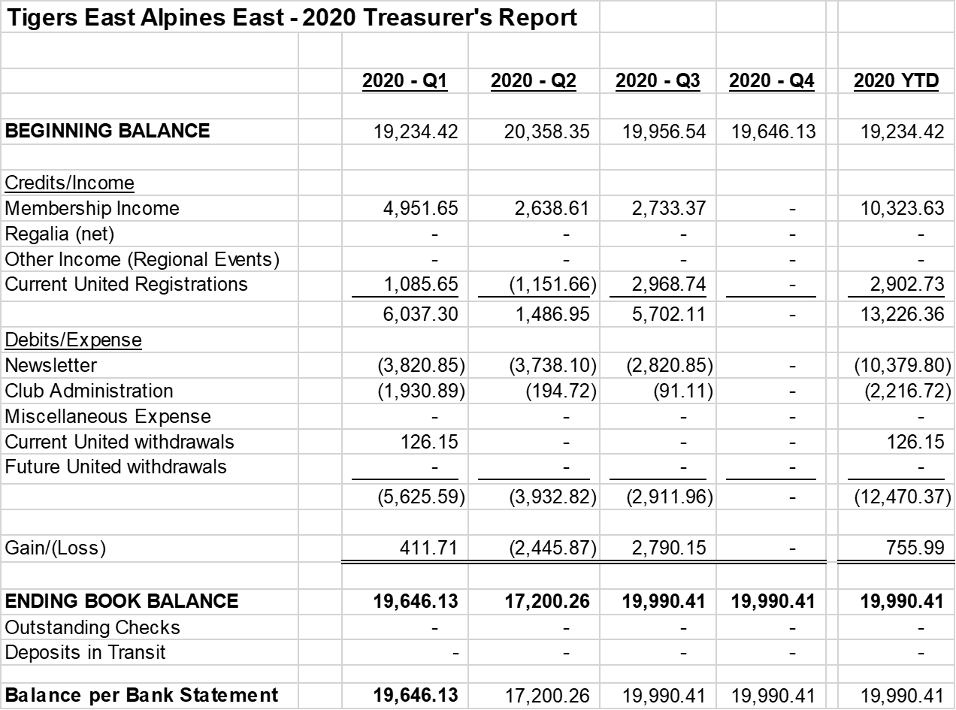

Slide 7
Summary
4 months still to tabulate
Approx. ($5,500) newsletter
Approx. $2,500 membership
($3,000)
No United to break even, but Hotel Deposit refunded

Slide 8
Membership Report Joe McConlogue

Slide 9
Membership as of Aug 1, 2020
Total members: 514
Free: 3
Courtesy: 12
Canadian rate: 29
CATO offer
40 Members / 3 already TEAE / 7 accepted
Members in 43 states / 5 provinces / DC & UK

Slide 10
Membership as of Aug 1, 2020
Dues
122 members (24%) have signed up or renewed at the new dues level
67 members (13%) have opted for auto-renewal
Newsletter Selection
340 (66%) printed
174 (34%) electronic

Slide 11
Membership as of Aug 1, 2020
Gains & Losses
117 members lapsed in last 12 month
63 were non-renewing Canadians
3 expired in July - may still renew
34 new members in last 12 months
Excluding Canadians, net loss of 20 members
Misc
No email for 31 members, bad address for 2

Slide 12
Editor/Webmaster Report Kerch McConlogue

Slide 13
Website March 1 thru August 1 Average Monthly Visits
Page | Total visits | Monthly | % of Total
Total visits | 40381 | 8076
Home | 5064 | 1013 | 13%
/login/ | 1889 | 378 | 5%
/rootes-reviews/ | 976 | 195 | 2%
Total forum | 9114 | 1823 | 23%
Total new topics | 31
Total replies | 45

Slide 14
How they find us
 | 2016 | 2017 | 2020
Organic Search Visitors look for us or Google doesn't know from where | 50% | 67% | 63%
Direct Links Visitors know just where to go | 30% | 22% | 24%
Referrals There's a link in something like an email, etc. | 20% | 11% | 11%
Social Linked from a social site | 1% |  | 2%

Slide 15
Facebook March 1 thru August 1
Total Membership | 509
Increase | 136
Posts | 236
Comments | 2002
Reactions | 2739
Forum usage
New topics | Replies
31 | 45

Slide 16
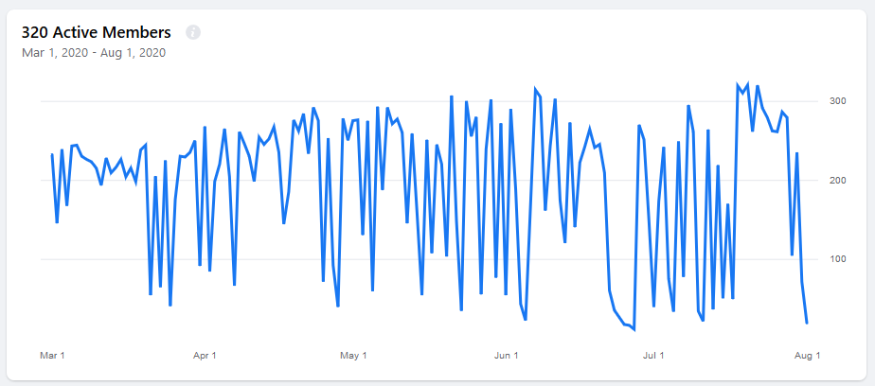
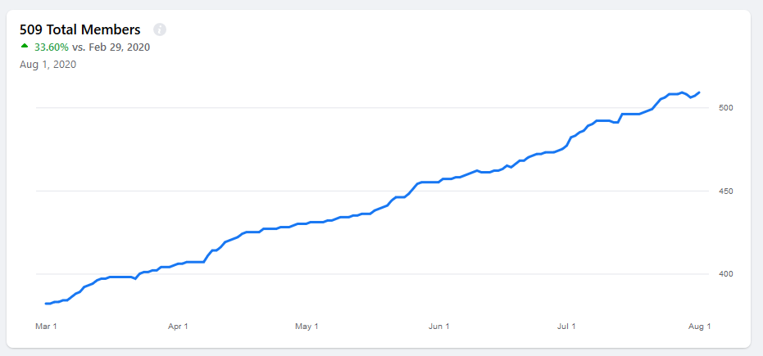
Facebook Engagement March 1 thru August 1

Slide 17
Demographics from Facebook
Age Range | Women | % Women | Men | % Men
13-17 | 0 | 0 | 1 | 0%
18-24 | 0 | 0 | 6 | 1%
25-34 | 2 | 0.4% | 26 | 5%
35-44 | 2 | 0.4% | 42 | 8%
45-54 | 9 | 1.8% | 104 | 21%
55-64 | 6 | 1.2% | 120 | 24%
65+ | 5 | 1.0% | 181 | 36%
Not surprising 60% of our members are over 55

Slide 18
Additional Reports Keep reports to 2 minutes

Slide 19
Old Business
Insurance
Sources of Revenue
Advertising
Regalia
SUNI Update
Preservation Class

Slide 20
Insurance
Feb meeting action item: Investigate insurance coverage alternatives.
Quote from Hagerty: Higher with less coverage
After board discussion decided to stay with J.C. Taylor
Need to confirm absolutely about Auto-x coverage. CAT reports J.C. Taylor no longer covers.

Slide 21
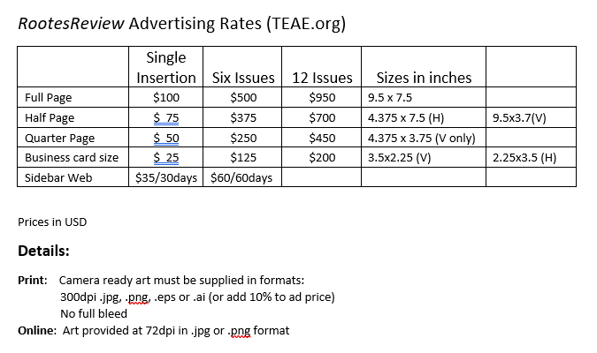
Sources of Revenue Advertising
Feb Meeting Action Item: Board approved concept of charging vendors for advertising in RootesReview and on website. Need to set rates and identify vendors.

Slide 22
Sources of Revenue Advertising
Kerch has volunteered to manage our advertising program.
Solicitation Package to vendors prepared (see read ahead)
Five packages sent…no answer received to date.
List of Targeted vendors
We have a list. Need a volunteer to obtain correct mailing addresses for all.
Preferred Vendors
Consider offering FREE advertising to very select vendors (Hagerty, Sunbeam, Specialties & Classic Sunbeam) in return for discounts for our members.

Slide 23
Sources of Revenue Regalia Sales
Feb Meeting Action Item: Sy Block to provide info on company that supposedly provides logo club regalia AND a cut to club on all sales.
Sy reports Queensboro is the name of the company.
Review of company website reveals their Premier Account Program is meant for companies with requirements for large orders of logo products. No mention of sharing sales.
Contacted Queensboro via email: No reply. Item closed

Slide 24
SUNI Update
Official dates: September 13-17, 2021 (5 day event)
Independence, MO locked in.
All six clubs (CAT, CATO, PTC, STOA, SAOCA & TEAE) have agreed to Cost/Revenue sharing plan
Host Hotel: Hilton Garden Inn Hotel Independence, MO. Contract being signed.
Invited Guests:
Rosemary Smith
Mike Jones
Lord Rootes (?)
Working on activity assignments
Kerch handling registration
STOA will likely run autocross

Slide 25
New Business
General Membership meeting.
2020 Elections
Regional Adjustments/New Regional Reps

Slide 26
General Membership Meeting
Sat September 26, 2020 @ 3:00 PM Eastern
Virtual meeting via same software as BOD
Major topics
Usual reports
Vote to approve changes to Bylaws
2020 Elections

Slide 27
2020 Elections
All officers and one Board member up for election
Do incumbents volunteer for another term?
Rollcall
Nomination
Nominations from general membership will be solicited at General Membership Meeting and via Rootes Review
Ballot in November Rootes Review
Discussion?

Slide 28
Regional Adjustment
Deep South: No Regional Rep. Members clustered at extreme east and west of region. Based on this the following adjustment is proposed:
Dissolve Deep South Region
Create Lone Star Region for members in Texas and Oklahoma (we have a Regional Rep candidate)
Divide eastern members between Atlanta Region (1 member in north MS) and North/Central Florida (4 members in coastal AL and MS). Reps from these regions are on board.
Discussion/Motion to Approve

Slide 29
Regional Adjustment
Great Plains: No Regional Rep. Only 5 members spread out over 3/4 million square miles. Based on this the following adjustment is proposed:
Dissolve Great Plains Region
Reassign western members (3 in MT & AB) to Pacific Northwest and the eastern members (2 in SD & NE) to Midwest Region. Regional rep affected is on board.
Discussion/Motion to Approve

Slide 30
Candidate for Regional Representative Lone Star Region
Rob Roy Keller, TX
Volunteered after recommendation by Bill Bulpitt and outreach by Joe McConlogue
Owner of four Tigers
TAC Inspector
Head of the informal club Tigers of North Texas
Discussion/Motion to Approve

Slide 31
Candidates for Regional Representative Erie Region
Tom Matowitz Mentor, OH
Bill Wright Slippery Rock, PA
Volunteered after outreach by Joe McConlogue
Both long time Alpine owners
Bio’s Forwarded
Discussion/Motion to Select one candidate

Slide 32
Candidate for Regional Representative Pacific Northwest Region
Brian Marks Vancouver, BC
Volunteered after outreach by Joe McConlogue
Tiger owner since 2004
Joined TEAE during Canadian initiative a couple years back
Bio Forwarded
Discussion/Motion to Approve

Slide 33
Candidate for Regional Representative Rocky Mountain Region
Roger Davis-Cottonwood, UT
Volunteered after outreach by Joe McConlogue
Owner of two Alpines
Vintage Racer
President of British Car club in his area
TEAE member since late 80’s
Bio Forwarded
Discussion/Motion to Approve

Slide 34
Preservation Class
Still trying to develop a suitable award for UNRESTORED cars
Several drafts have been distributed and the comments received incorporated. March draft showed necessary rule changes and Judging sheets. Resent this month.
March Comment: TT recommended choose a better word than “finish” when describing compartment layout category on Judging sheets. Finish could denote quality. Changed to “Compartment Layout and Painted Surfaces.”
Key Points
Open to all models
Judging for Originality ONLY (Quantitative NOT Qualitative)
Judging is against a standard…NOT other cars.
Awards are perennial…bumper badge
Judging sheets not that different
Most knowledgeable judges
Judging relies significantly on interaction with owners and YES, the honor code has much to do with results

Slide 35
Wrap Up
Any other items to Discuss?
Motion to Adjourn

