Slide 1

Tigers East/Alpines East
Board of Directors
Semi-Annual
Web Conference
July 31, 2021

Slide 2
Agenda
Welcome
Roll Call
Review Approve Feb 2021 Meeting Minutes
United 2022
Reports
Old Business
New Business
Adjourn

Slide 3
TEAE UNITED 2022
Proposal For Oakville, Ontario, Canada
September 15-18, 2022

Slide 4
HOST FACILITY
Holiday Inn in Oakville, Ont
Location – Western end of Lake Ontario. Close to Buffalo border crossing – approx. 75 minutes from the border.
Room Rate - US$120 including buffet breakfast (Taxes extra)
Hospitality Suite and Parts Room space on main level. Cost is very reasonable ($75/day).
Banquet Room – No additional charges beyond meal charges with $2kCdn minimum total. Nominal charges for podium and projector w/screen.
Separate Car Washing and Parking areas to be provided. Also room on-site for tow vehicles and trailers.

Slide 5
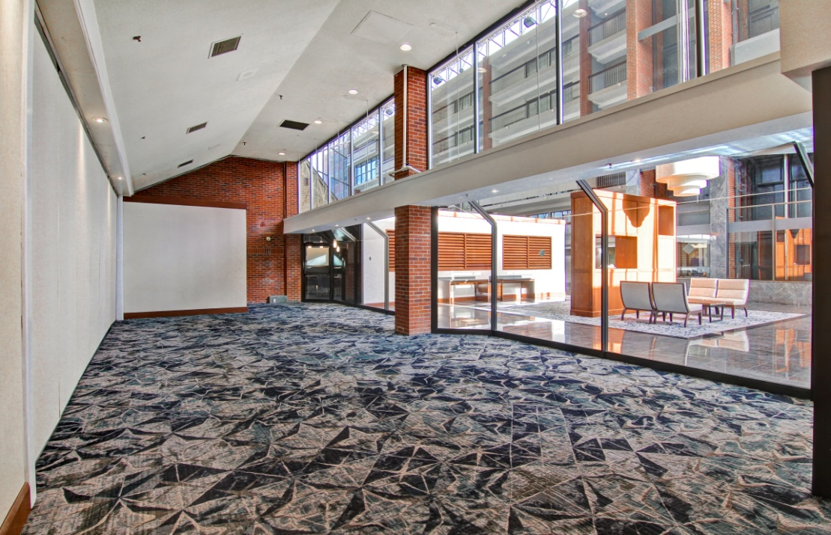
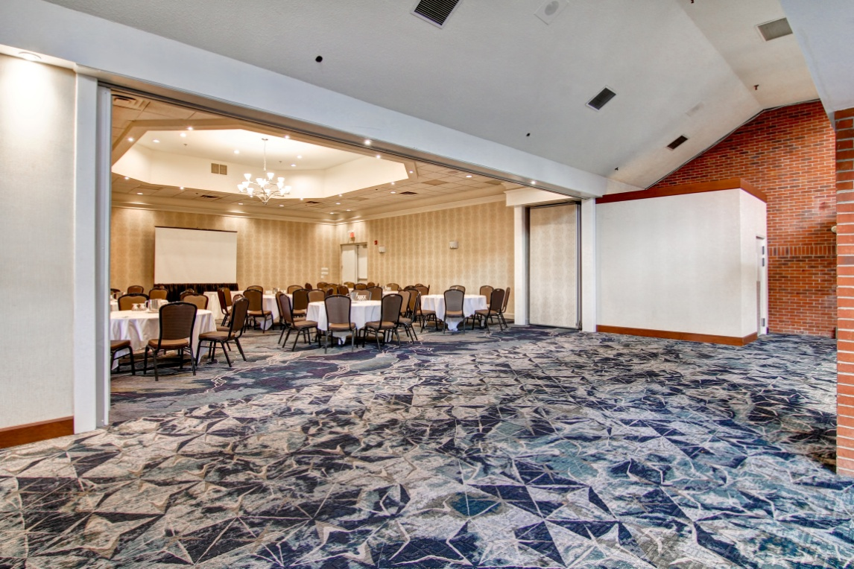
HOST FACILITY

Slide 6
SCHEDULE OF EVENTS
Thursday – Welcome/Registration, Parts Room, Hospitality Suite
Friday – Legendary Motorcars Tour, Driving Tour, Parts Room, Hospitality Suite
Saturday – Autocross, 'Other' Activity, Parts Room, Hospitality Suite
Sunday – Concours, AGM, Banquet, Parts Room, Hospitality Suite
TAC Session? There could be great interest, and it would be an opportunity to train inspectors in Canada.

Slide 7
NON-CAR ACTIVITIES
Driving Tours – Lots of interesting sideroads nearby!
Craft Breweries
Niagara Falls
Wineries
Hamilton Air Museum
Toronto Downtown – Subway station within 10 minutes. Many attractions – Toronto International Film Festival, Harbourfront and Islands, CN Tower, Ripley’s Aquarium, possible baseball game at the Rogers Centre

Slide 8
Budget Estimates
EXPENSES | Target # | Cost Each - $Cdn | Total Cost - $Cdn | Total Cost - $US
Dash Plaques | 100 | 3 | 300 | 240
Badge Holders | 100 | 2 | 200 | 160
Event Momentos | 100 | 10 | 1000 | 800
Parts Room & Hospitality Suite Rental | 4 | 75 | 300 | 240
Hospitality Suite - 4 Days Supplies | 100 | 50 | 5000 | 4000
Hospitality Suite - Permit |  |  | 200 | 160
Friday - Legendary Motorcars Tour | 100 | 5 | 500 | 400
Friday - Lunch | 100 | 20 | 2000 | 1600
Saturday - Autocross | 20 | 100 | 2000 | 1600
Saturday - Other Activity | 80 | 20 | 1600 | 1280
Sunday - Concours Participation | 60 | 15 | 900 | 720
Sunday - Concours Extra Parking | 12 | 20 | 240 | 192
Sunday - Concours Trophies | 30 | 50 | 1500 | 1200
Sunday - Banquet Meal Cost | 100 | 55 | 5500 | 4400
Sunday - Banquet Screen & Projector Cost |  |  | 315 | 250
T Shirts | 50 | 20 | 1000 | 800
Golf Shirts | 50 | 30 | 1500 | 1200
Registration PayPal fees |  |  | 800 | 640
Administrative Supplies |  |  | 300 | 240
Contingency |  |  | 300 | 240
Total Expenses |  |  | 25455 | 20362
INCOME
Registration-Single | 20 | 225 | 4500 | 3600
Registration-Couple | 40 | 400 | 16000 | 12800
T shirts | 50 | 30 | 1500 | 1200
golf shirts | 50 | 40 | 2000 | 1600
Autocross | 20 | 75 | 1500 | 1200
Total Income |  |  | 25500 | 20400
NET PROFIT |  |  | 45 | 38

Slide 9
DECISION REQUESTED
Approval in principle of this proposal
Will enable me to solicit a detailed proposal from Holiday Inn to finalize contract for host facility
Motion to approve?

Slide 10
Reports
Treasurer’s Report
Membership Report
Website/Editor’s Report
Additional Reports as Required

Slide 11
Treasurer’s Report

Slide 12
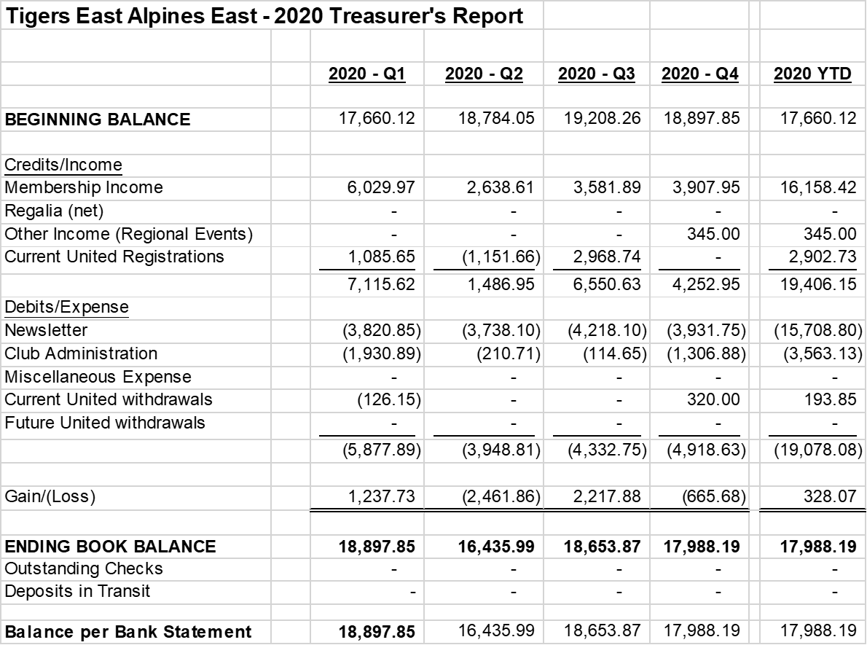
2020 Balance Sheet

Slide 13
2021 Balance Sheet (as of June 30)

Slide 14
Membership Report
Joe McConlogue

Slide 15
Membership Breakdown
511 members (up 14 from February)
  20 new members in that period and 6 dropped out
  3 free members:
    Jim Morrison. Dave Lawler & Brad Davis
  13 courtesy members, added Rootes Archive Center
  25 members at Canadian rate for electronic newsletter (up 1 from February)
  No or invalid email for 27 members (5.3%)
Newsletter selection
  192 electronic (37.6%) (slight tick up)
  319 printed (62.4%) (incl 5 international)

Slide 16
Gains and Losses
  2020: Lost 65 members/gained 34 (Net Loss: 31)
Membership Levels 2017-21
  2021 – 511
  2020 – 510
  2019 – 584 (Canadian initiative)
  2018 – 501
  2017 – 495

Slide 17
Editor/Webmaster Report
Kerch McConlogue

Slide 18
Rootes Review
2021 monthly page count and associated costs.
Month | No. of Pages | Monthly Cost
January | 12
February | 12
March | 12
April | 16 | 1426 (FIRST CLASS)
May | 16
June | 20 | 1574 (first class)
July | 20 | 1441 (3rd class)
August | 20?
September
October
November
December
Total

Slide 19
Facebook
March 1 thru August 1
 | 3/1 thru 8/1 2020 (4 mos) | 8/1 thru 2/1 2021 (6 mos) | 2/1 thru 7/27 (~6 mos)
Total Membership | 509 | 602 | 663
Posts | 236 | 311 | 181
Comments | 2002 | 25499 | 1250
Reactions | 2739 | 4684 | 2029

Slide 20
Website: Average Monthly Visitors and Page Views
Comparing March 1 thru August 1, 2020
August 1 thru February 1, 2021
February 1, 2021 thru July 27, 2021
 | Total users:
3/1 thru 8/1 (5 months) 8/1 thru 2/1, 2021 (6 months) 2/1 thru 7/28 (~6 months) | 8076 7960 9890
Pages | Monthly
Home: 3/1 thru 8/1 8/1 thru 2/1, 2021 2/1 thru 7/28 (~6 months) | 1013 701 946
/login/: 3/1 thru 8/1 8/1 thru 2/1, 2021 2/1 thru 7/28 (~6 months) | 378 139 309
/rootes-reviews/: 3/1 thru 8/1 8/1 thru 2/1, 2021 2/1 thru 7/28 (~6 months) | 195 132 152
All forum: 3/1 thru 8/1 8/1 thru 2/1, 2021 2/1 thru 7/28 (~6 months) | 1823 1793 1836
Notes:
182 INCORRECT PASSWORDS
82 RESET PASSWORDS
CARBURETOR ID 1426
Cooling the tiger 798
Resting seats 590
Restoring doors 426

Slide 21
Additional Reports
Keep reports to 2 minutes

Slide 22
Old Business
Update Paid Advertising
SUNI Update
Membership Incentives

Slide 23
Advertising Revenue
Update

Slide 24
SUNI Update
175 people/90 cars
48/110 registrations from TEAE (43.6%)
  Represents our share of profit
  Hotel block 100% filled...no chance of loss
COVID Concerns
  International participation almost nil
  Recent surge in cases/variants
  No change, as of now, in local restrictions…None
Unbudgeted expense
  Overwhelming demand for trailer space (65)
    Had to rent space from local shopping center $2500
Concours
  TEAE scoring rules in effect
  Three judge teams, judge entire car

Slide 25
New Business
2021 Elections

Slide 26
2021 Elections
Volunteers to run again?
Any other nominations
Will seek nominations from General Membership
  At General Membership meeting @ SUNI
  Announcement in September Rootes Review
Election
  Distribute Ballot via email and Rootes Review in Nov
  Election runs through late December
  Results announced in January 2022 Rootes Review

Slide 27
Wrap Up
Any other items to Discuss?
Motion to Adjourn

Slide 28
Back-up Slides

Slide 29
EXPENSES | Target # | Cost Each - $Cdn | Total Cost - $Cdn | Total Cost - $US
Dash Plaques | 100 | 3 | 300 | 240
Badge Holders | 100 | 2 | 200 | 160
Event Momentos | 100 | 10 | 1000 | 800
Parts Room & Hospitality Suite Rental | 4 | 75 | 300 | 240
Hospitality Suite - 4 Days Supplies | 100 | 50 | 5000 | 4000
Hospitality Suite - Permit |  |  | 200 | 160
Friday - Legendary Motorcars Tour | 100 | 5 | 500 | 400
Friday - Lunch | 100 | 20 | 2000 | 1600
Saturday - Autocross | 20 | 100 | 2000 | 1600
Saturday - Other Activity | 80 | 20 | 1600 | 1280
Sunday - Concours Participation | 60 | 15 | 900 | 720
Sunday - Concours Extra Parking | 12 | 20 | 240 | 192
Sunday - Concours Trophies | 30 | 50 | 1500 | 1200
Sunday - Banquet Meal Cost | 100 | 55 | 5500 | 4400
Sunday - Banquet Screen & Projector Cost |  |  | 315 | 250
T Shirts | 50 | 20 | 1000 | 800
Golf Shirts | 50 | 30 | 1500 | 1200
Registration PayPal fees |  |  | 800 | 640
Administrative Supplies |  |  | 300 | 240
Contingency |  |  | 300 | 240
Total Expenses |  |  | 25455 | 20362

Slide 30
Income | Target # | Cost Each - $Cdn | Total Cost - $Cdn | Total Cost - $US
Registration-Single | 20 | 225 | 4500 | 3600
Registration-Couple | 40 | 400 | 16000 | 12800
T shirts | 50 | 30 | 1500 | 1200
golf shirts | 50 | 40 | 2000 | 1600
Autocross | 20 | 75 | 1500 | 1200
Total Income |  |  | 25500 | 20400
NET PROFIT |  |  | 45 | 38

