Slide 1
Tigers East/Alpines East Board of Directors Semi-Annual Web Conference February 12, 2022

Slide 2
Agenda
Welcome
Roll Call
Reports
Old Business
New Business
Adjourn

Slide 3
Reports
Review and approval of August BoD Meeting Minutes
Treasurer’s Report
Membership Report
Website/Editor’s Report
Additional Reports as Required

Slide 4
Treasurer’s Report Rob Harter

Slide 5
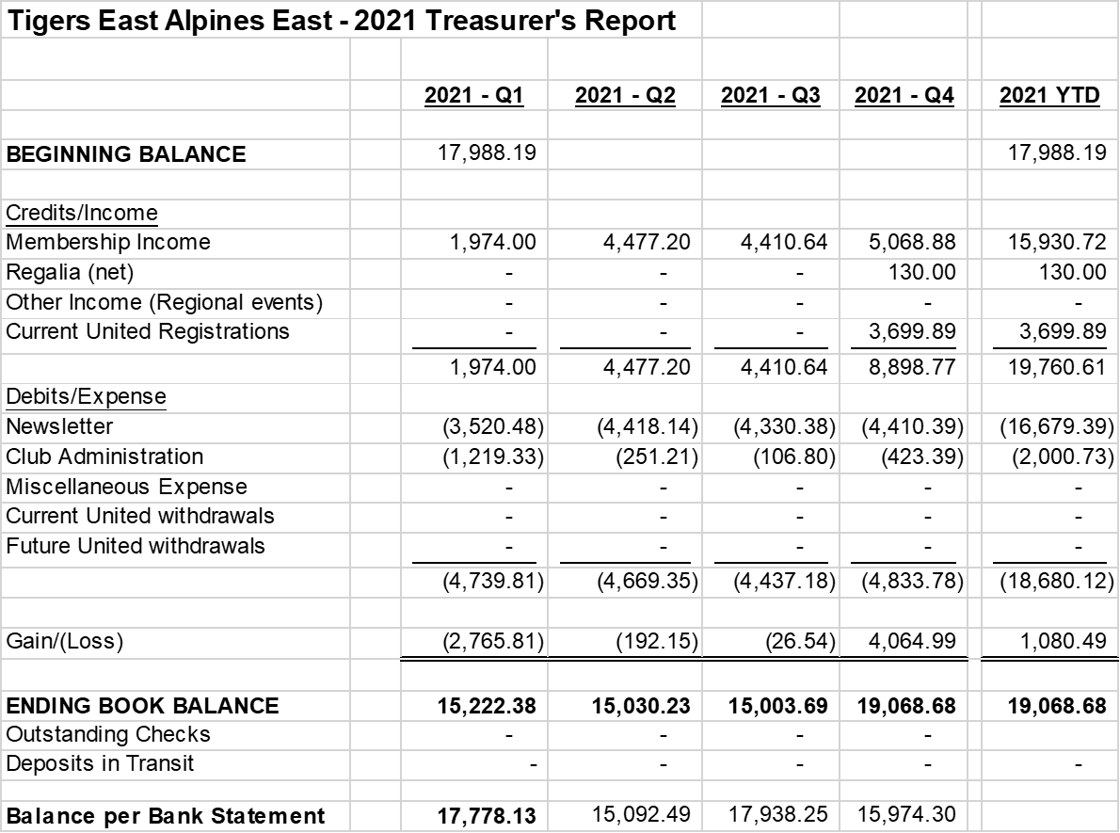
2021 Balance Sheet

Slide 6
Annual Profit/Loss Comparison
2021 - $1,080.49 (would be roughly ($2,619.40) without SUNI profit)
2020 - $328.07 (would be roughly ($2,640.67) if we didn’t get United refund or United financials)
2019 – ($2,743.13)
2018 – ($1,878.22)
Negative Trend based on Membership vs. Newsletter, but Newsletter is “The Quality Product” wanted by all Members

Slide 7
Membership Report Joe McConlogue

Slide 8
Membership Breakdown
519 members (up 8 from July 2021)
23 new members in that period and 15 dropped out
3 free members:
Jim Morrison. Dave Lawler & Brad Davis
27 members at Canadian rate for electronic newsletter (up 2 from July)
Newsletter selection
210 electronic (40.4%) (up about 2%)
310 printed (59.7%) (incl 7 international)
13 courtesy newsletters

Slide 9
Gains and Losses
Feb 2022 – 519
July 2021 – 511
2020 – 510
2019 – 584 (Canadian initiative)
2018 – 501
2017 – 495
In 2021: Lost 40 members/gained 54 (Net Gain 14)

Slide 10
Misc Data
No or invalid email for 23 members (4.4%)
62 members (31%) have selected auto-renewal for their dues
2,451 vehicles and 324 full or partial VINs in our database
1,346 Tigers (204 vins)
933 Alpines (89 vins)
47 other Rootes (5 vins)
24 other marques (5 vins)

Slide 11
PayPal / Stripe
PayPal
3.49% + $0.49USD/ +$0.59CND plus 1.5% for cross-border transactions
US Print $45 -> $42.94
US Elect $35 -> $33.29
CDN Elect C$35 -> $24.82
CDN Print US$54 -> $51.53
Stripe
2.9% + $0.30USD plus 1% for intl card plus 1% for currency xfers
US Print $45 -> $43.39
US Elect $35 -> $33.68
CDN Elect C$35 ->$26.04
CDN Print US$54->$51.03

Slide 12
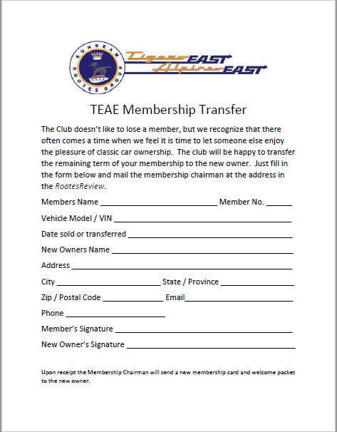
Membership Transfer Proposal
Problem: when cars change ownership members drop out
Purpose: to maintain membership levels
Solution: give the new owner something

Slide 13
Editor/Webmaster Report Kerch McConlogue

Slide 14
Rootes Review
Monthly page count and associated costs.
Month | No. of Pages | Monthly Cost
January 2022 | 12 | $1194 (first class)
February 2022 | 12 | (first class)
March 21 | 12
April 2021 | 16 | $1426 (FIRST CLASS)
May21 | 16
June21 | 20 | $1574 (first class)
July 21 | 20 | $1441 (third class)
August 21 | 16
September 21 | 16 | $1444 (third class)
October 21 | 16 | $1444 (third class)
November 21 | 20 | $1648 (third class)
December 21 | 12 | $1104 (third class)

Slide 15
No progress on Advertising
Added one RR business card size
Poked at a couple places but nothing back.

Slide 16
Website
Trouble with old images being lost caused a giant mess with members’ payment reminders

Slide 17
Website: Average Monthly Visitors
 | Total users:
3/1 thru 8/1 (5 months) 8/1 thru 2/1, 2021 (6 months) 2/1 thru 7/28 (~6 months) 8/1 thru 2/1 2022 | 8076 7960 9890 10887
Forums continue to be the top of the link list
Carburetor-identification has nosed Cooling the Tiger out of the top 10 pages
How to restore your seats was #20 (447 hits)
The United survey 786 hits on the survey
Notes:
182 INCORRECT PASSWORDS
82 RESET PASSWORDS
CARBURETOR ID 1426
Cooling the tiger 798
Resting seats 590
Restoring doors 426

Slide 18
Facebook August 1 thru February 1
 | 3/1 thru 8/1 2020 (4 mos) | 8/1 thru 2/1 2021 (6 mos) | 2/1 thru 7/27 (~6 mos) | 8/1 thru 2/1 (6 mos)
Total Facebook Membership | 509 | 602 | 663 | 889

Slide 19
Additional Reports Keep reports to 2 minutes

Slide 20
Old Business
United 39 Update

Slide 21
United 39 Update - Accomplishments
Hotel - Contract signed. 60 room reservations made by end-Jan 22.
United 39 webpage set up on TEAE website, Event Schedule posted.
Series of newsletter articles started for Rootes Review and Canadian Newsletter.
Goodie Bags - Hagerty will provide 100 bags, we have started to source things to include.
Banquet - Started to source door prizes.
Concours & Autocross - Initial discussions held with these independent organizers.

Slide 22
United 39 Update – Next Steps
Budget Review
See Latest spreadsheet
Event Registration Fee Recommendation - $225Cdn Single/$425 Couple. With current exchange rate around .78, that would be $175US Single/$330US Couple.
Different registration fees for Member/Non-Member
Single Day Fee (to give access to the hospitality room and parts room) - proposing $20. Activity participation would be extra.
Agree on final fees
Event Registration - Set up initial registration process through TEAE website, and process for on-site registration (work with Kerch and Rob).
Solicit topics of interest for tech sessions.
Banquet Menu finalized (Tentatively end-March).
Purchase of Supplies (Shirts, Hospitality suite supplies).
Autocross - (Ron)
Concours - (Gord)
Website - Update & create additional content (Schedule, Parts import process, COVID).

Slide 23
New Business
Club Insurance
Search for Officer Replacements
Proposal to amend Concours Judging Procedures
Donation to Rootes Archive
Location for United 40 (2023)

Slide 24
Club Insurance
Current - J.C. Taylor
Up for renewal – 19 Mar 22
Coverage
General Liability: $1M/$2M
Policy is intended to cover a small business…also includes “stretch coverage” for wide range of risks not necessarily needed for car club
Covers car shows and driving tours. Autoross coverage is NOT AVAILABLE
Premium History:
2018: $1300
2019: $1250
2020: $1044
2021: $1068
Cost for 2022: $1183

Slide 25
Club Insurance—Other Options
Hagerty: More expensive than JC Taylor for basic coverage
American Specialty Ins Ft. Wayne, IN
Brokered through Starke Shelby, Northwest Insurance Center Mercer Island, WA
Shelby is Sunbeam owner and PTC member
Coverage is provided through a car club association owned by American Specialties…Mountain Pacific Car Club Association
30+ member clubs including CAT, STOA and PTC
Coverage for clubs is provided under umbrella policy for the association
General Liability $1M/$5M
Additional coverage for “moving events” available as required
Cost:
Basic General Liability: $565/annum
Moving event: $200/event
Auto-X and driving tours are SEPARATE events

Slide 26
Search for Officer Replacements
Midwest Regional Rep currently vacant
Kevin Klotzbach Woodbury, MN has volunteered
Discussion/Motion/Vote
Need to identify Treasurer candidates
Need to identify other future officer candidates

Slide 27
Change Concours Judging Procedures
Proposal: Change number of judges per team to three judges.
One team judges ENTIRE car
One team judges entire class (no change)
Fewer judges needed
Current system requires two judges for each component area…that’s 10 judges/class vs. 3
Third judge provides tie breaker
Worked well at SUNI
Discussion/Motion/Vote

Slide 28
Change Concours Judging Procedures
Proposal: In the Personalized and Modified classes eliminate Suspension and Chassis (underside) as judged component area.
What do we really judge in these areas?
Clean/Shiny ones get max points
Dirty/Rusty undersides lose a point.
In assessing the engineering and quality of modifications, we can get what we need by talking with owner
Difficult to judge…Judges are not getting any younger
Team of judges at SUNI refused to judge this area, said they were not physically able.
Will remain judged area in Stock Class
Discussion/Motion/Vote

Slide 29
Donation to Rootes Archive
Received solicitation for donation from Rootes Archive
Do we want to make a donation this year?
Last donation was $1,200 in 2020
Discussion/Motion/Vote

Slide 30
United 40 Location
Need to begin planning for United 40 (2023)
Possible venues??? We need to go South
Have not been to Deep South since 2016 (Atlanta)
Have not been to Florida since 2008 (Daytona)
Volunteer? Often determines location.
If all else fails, can reboot NC as possible option
Discussion

Slide 31
Wrap Up
Any other items to Discuss?
Motion to Adjourn

Slide 32
Backup Slides

Slide 33
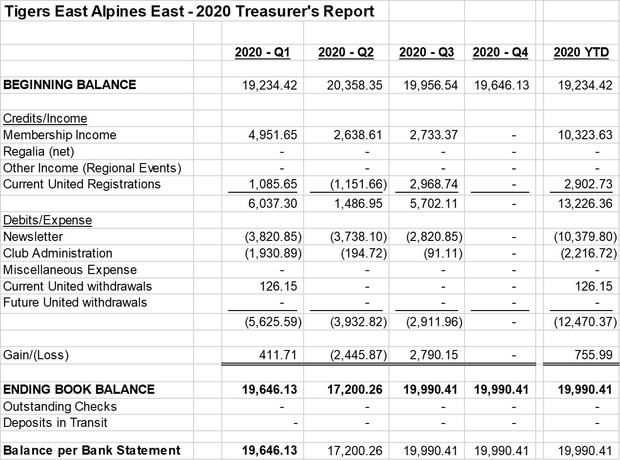
2020 Balance Sheet

Slide 34
2019 Balance Sheet

Slide 35
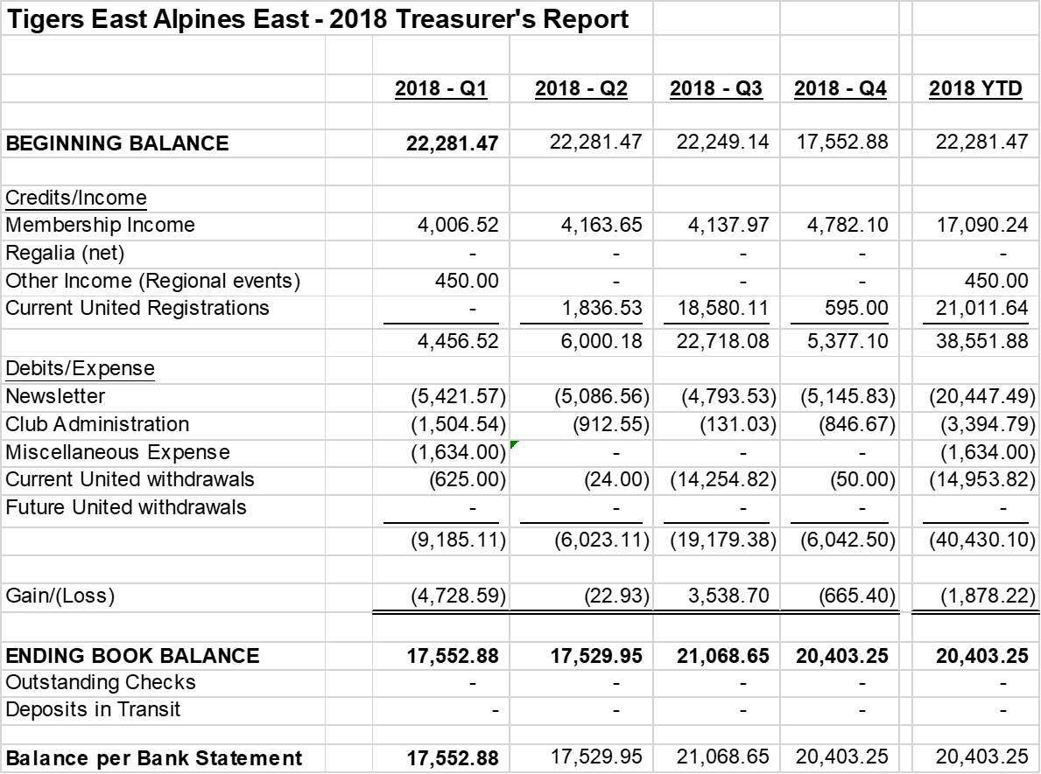
2018 Balance Sheet

