Slide 1

Tigers East Alpines East
Board of Directors
Semi-Annual Conference
Feb 5, 2023

Slide 2
Agenda
Welcome
Roll Call
Reports
Old Business
New Business
Adjourn

Slide 3
Reports
Review and approval of July BoD Meeting Minutes
Treasurer’s Report
Membership Report
Website/Editor’s Report
Additional Reports as Required

Slide 4
Treasurer’s Report
Rob Harter

Slide 5
5 Year Summary
CY | 2018 | 2019 | 2020 | 2021 | 2022
Starting Balance | 22281 | 20553 | 17660 | 17988 | 19068
Ending Balance | 20553 | 19234 | 17873 | 15974 | 23061
Membership | 17090 | 15831 | 16158 | 15930 | 16398
Newsletter | 20447 | 20062 | 15708 | 16679 | 16298
 | -3357 | -4231 | 450 | -749 | 100
SUNI | 0 | 0 | 0 | 0 | 3699
United | 3057 | 7524 | 3096 | 0 | 4355
RAC Donations | 502 | 500 | 1200 | 0 | 0
Thanks for letting me be Treasurer for 5 years,
We welcome: Steve Murphy

Slide 6
Membership Report
Joe McConlogue

Slide 7
Membership Breakdown 2022
509 members
  In 2022:
    35 new members joined
    47 memberships lapsed
    Net change -12
Newsletter selection
  198 electronic (incl 30 Canadian)
  311 printed (incl 3 lifetime, 8 intl)
  Change is 1.6% toward electronic
Dues payment
  32% pay by check
  68% pay by credit card
  Change is 4% toward credit cards
    58% by PayPal and 42% by Stripe (13% change toward Stripe)
Misc Data
  70 members (14%) use auto-renewal
  22 members (4%) have not provided an email address

Slide 8
Editor/Webmaster Report
Kerch McConlogue

Slide 9
Rootes Review
Month | No. of Pages | Monthly Cost
January | 12 | $ 1194*
February | 12 | $ 1087
March | 12 | $ 1177*
April | 12 | $ 1177*
May | 32 | $ 2388 †
June | 20
July | 16 | $ 1535
August | 16 | $ 1553
September | 16 | $ 1560
October | 16 | $ 1563
November | 20 | $ 1829
December | 12 | $ 1091*
 | 2022 total | ~ $ 16,154
Estimate cost 12 issues/year
Average pages | 16
Cost for 16 pages | $ 1,550
Annual cost | $ 18,600
Estimate cost 6 printed issues/year 12 published/year
Average pages | 32
Cost for 16 pages | $ 1,800
Annual cost for 6 issues | $ 10,800
* Mailed first class
† This was previously shown as $1718 which is what we paid. But the total SHOULD have been $2388

Slide 10
Facebook
Total membership 1025
Top countries
United States | 803
United Kingdom | 115
Canada | 74
Australia | 32
South Africa | 15
Top cities
London, UK | 8
Melbourne, VIC, Australia | 8
Sydney, NSW, Australia | 7
Ottawa, ON, Canada | 6
Pompano Beach, FL | 5
Member ages
older than 65 | 40%
55-64 | 28%
45-54 | 12%

Slide 11
Website: Average Monthly Visitors
Around 8,800 / month
Home page visitors are about 14% of total
Forums continue to be the top of the link list (about 12% of visitors)
Visitors to Carburetor-identification (3.43%) has continued to surpass Cooling the Tiger
(at just .83%)
How to restore your seats was #20 (447 hits)
The United survey 786 hits on the survey
Links to member-based pages is at about 5.4% of total visitors

Slide 12
Website Updates
Working to reconnect the images that were disconnected
Worked with Gary Corbett to consider new layout with more visual navigation

Slide 13
Additional Reports
Keep reports to 2 minutes

Slide 14
Old Business
United 40 Update
Three Year Business Plan Committee
Donation to Rootes Archive

Slide 15
United 40
Venue: Bowling Green, KY
Dates: Sep 14-17, 2023
Fee: $185/$210 single $350/$385 couple
  Shirts: Tee-$20, Polo-$35 (pending)
Host Hotel: Holiday Inn University Plaza
  Room Rate $130 incl breakfast. Guaranteed room block=50 rooms/night (200 room nights). 3 days Early arrival/Late departure same rate
  Nice Parts Room and Hospitality Suite
  More than adequate parking for cars and trailers
  $250 rebate for every 10 room nights above 80% of room guarantee (160). If we got usual turn-out it should cover the cost of the public rooms…maybe more.
Registration open o/a April 1st

Slide 16
United 40
Planned Activities
  Thursday:
    Track time at National Corvette Museum MotorSports Park…Confirmed. Separate registration thru NCM. $100/4 laps
  Friday: (Cost incl in Registration)
    Scenic AM drive followed by Lunch and tour of National Corvette Museum (NCM)
    Welcome Reception/General Membership Meeting/Movie
  Saturday: (Cost incl in Registration)
    Concours: Venue: Fenced in Grassy area adjacent hotel. Boxed lunch delivered to show field
    Guest Speaker: Evening presentation. Tom Patton (tentative)
  Sunday: (Cost incl in Registration fee except Autocross)
    Autocross: Piggyback on KYSCCA event confirmed. Separate registration thru Motorsportsreg.com $50/pp
    Kart Racing: NCM Motorsports Park
    Lanes Auto Museum Nashville
    Mammoth Cave Tour
    Banquet (Brad Phillips MC tentative: trophies by Joe Parlanti)

Slide 17
United 40 Budget Estimate
Budget Expenses |  |  | KY. Tax = | 6.00%
 | Cost ea | Target # | Cost | Tax/Ship | Total Exp
United dash plaques | $2.50 | 100 | $104.30 |  | $250.00
Trophies | $25.00 | 30 | $1,050.00 |  | $750.00
Badge Holders | $1.00 | 150 | $150.00 |  | $150.00
Event Memento-Pub Glass | $6.00 | 144 |  |  | $864.00
Friday Night Reception all incl |  |  | $1,750.00 |  | $1,750.00
Banquet all incl |  | 125 | $0.00 |  | $7,500.00
Hosptitality Beverages/Snacks |  |  |  |  | $1,500.00
Corvette Museum Tour/Lunch | 26 | 100 | 2600 |  | 2,600.00
Concours Lunch all incl |  | 125 | $0.00 |  | $2,800.00
Autocross | $600 | 15 | $600.00 |  | $600.00
Kart Racing | $20 | 25 |  |  | $500.00
Lanes Auto Museum | $10 | 40 |  |  | $400.00
Mammoth Cave Tour | $16 | 20 |  |  | $320.00
Parts/Reg Room Set Up |  |  |  |  | $750.00
T shirts | $17 | 40 |  |  | $680.00
Golf Shirts | $25 | 40 |  |  | $1,000.00
Registration PayPal Fees |  |  | $700 |  | 700.00
Administrative Supplies |  |  | $100 |  | 100.00
Contingency |  |  |  |  | 300.00
Total Budget Expenses |  |  |  | $0.00 | $23,514.00
Registration-Single | $185.00 | 25 |  |  | $4,625.00
Registration-Couple | $350.00 | 50 |  |  | $17,500.00
T shirts | $20.00 | 40 |  |  | $800.00
golf shirts | $35.00 | 40 |  |  | $1,400.00
Rebate for Room Minimum |  |  |  |  | $1,000.00
Total Income |  |  |  |  | $25,325.00
Total Expenses |  |  |  |  | $23,514.00
Total Budget Surplus/Deficit |  |  |  |  | $1,811.00

Slide 18
Three Year Business Plan Committe
At Board meeting last July Tiger Tom proposed; and the Board approved, the formation of a Three Year Business Plan Committee (3YPC)
Results to date

Slide 19

Three Year Planning Committee
● Report
● Recommendations
● BOD Action Plan ?

Slide 20
Three Year Planning Committee
Membership Criteria:
  Representatives, Officers & Members across USA & Canada
10 Members: Tom Ehrhart, Facilitator
Bill Bulpitt, Rep
Rich Fritz, Mbr
Eric Gibeaut, BOD
Kevin Klotzbach, Rep
Kerch McConlogue, RR Ed & Website
Joe McConlogue, Mbrshp; BOD
Joe Montecalvo, Rep
David Renia, BOD
Ron Stein, Canada Rep
Three (3) ZOOM calls Oct-Nov 2022

Slide 21
MISSION
Identify financially executable practices and procedures TEAE should pursue to better serve the Rootes Marque in North America.
OBJECTIVES
- Identify/list the club’s strengths, accomplishments
- Identify the club’s weaknesses or needs
- Identify opportunities & ideas to pursue
- Identify risks, conflicts and threats
PROCESS
- Capture thoughts, ideas, opinions
- Develop actionable opportunities & ideas to pursue
- Develop actionable plan the BOD can execute

Slide 22
The Three-Year Planning Committee recommends the Board of Directors pursue the suggestions that follow. Several will require engaging others with leadership skills to execute and committees to be formed. The Planning Committee should be consulted for recommendations.

Slide 23
3PC RECOMMENDATIONS
 FACEBOOK
 FORUM
 ON-LINE TECH SESSIONS
 TAC
 SHOP LISTS
 WEBSITE
 CLUB REPRESENTATIVES
 BRANDING / MARKETING
 FINANCIAL
 CLUB OPERATIONS
 LEADERSHIP INITIATIVES

Slide 24
3 PC COMMITTEE RECOMENDS the BOD approve the following:
(As described in (21 Nov 2022) report submitted to BOD)
 Amend Bylaws;
    Article X (Regional Reps)
    Article XIV (Financial)
    Remove Policy & Procedures and create BOD approved P & P
     $5 Discount for 1st year electronic subscribers

Slide 25
Recommend board approve the formation of:
  A standing committee of members to maintain a club presence on
  Facebook.
  2. A standing committee of members to produce technical videos.
  A committee to make recommendations with regard to the Wally Smith and Keith Porter awards.
  An expansion of TAC activities by TEAE.
  Preparation of a regalia plan including a plan for any seed money required.
  A volunteer should be sought to investigate qualifications for 501 (c)3 tax status.
  7. Approval to investigate options altering club logo & name to
  de-emphasize EAST

Slide 26
(Continued) Recommend board approve the formation of:
8. Move that the board support the goals of the organization to include expansion of the membership to include owners of not only Tigers and Alpines but all Rootes vehicles, and members not only the eastern US but throughout North America.

Slide 27
ACTION PLAN ?
Who does what ???

Slide 28
 Facebook Standing Committee
 Forum Moderator
Standing Committee to produce On-Line Technical Videos
 Wally Smith and Keith Porter award review committee
 TAC TEAE initiative
 Regalia Plan
 501(c)3 initiative volunteer
 Shop List coordinator
 Website technical content organization & content access?

Slide 29
 Regional Rep:
A. Periodic conference/Zoom call
B. Promote BASH initiative
 Financials, Review & adopt proposals
 Club Operations:
A. Succession Planning
B. Bylaws- Policy & Procedures

Slide 30
 Leadership Initiatives:
A. Expand BOD
B. Marque Authority
C. Target Western membership
D. Recruit Members to assist
E. United’s in Mid-West and West
F. Pursue 501(c) 3 Status
G. Legacy Awards review

Slide 31
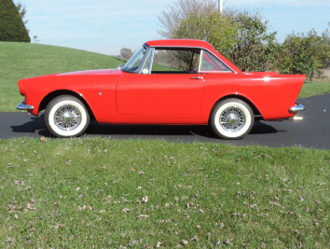

LET’S ROLL

Slide 32
Donation to Rootes Archive
Solicitation from Rootes Archive Jan 2021
Board voted in Feb and July 2021 to postpone decision on any donation pending budget developments
Do we want to donate this year?
Discussion/Motion/Vote

Slide 33
New Business
United 41 (2024)

Slide 34
United 41 (2024)
Robert Jaarsma has agreed to lead the planning for a New England United for 2024
Robert reports that West Lebanon, NH has everything we need and he has done preliminary research
  Fireside Inn host hotel (Intersection of I-91 & I-89)
  Plenty choices for concours venue
  Many scenic drives available
  Preliminary contact with NHSCCA about autocross favorable for piggyback event
Scheduling options
  Early October to take advantage of fall colors
  Same weekend (Mid-Sep) as British Invasion in Stowe, VT
  (1 hr 15 min drive)
Recommend continued planning and presentation for approval at summer BoD Meeting.
Discussion

Slide 35
Wrap Up
Any other items to Discuss?
Motion to Adjourn

Slide 36
Backup Slides

Slide 37
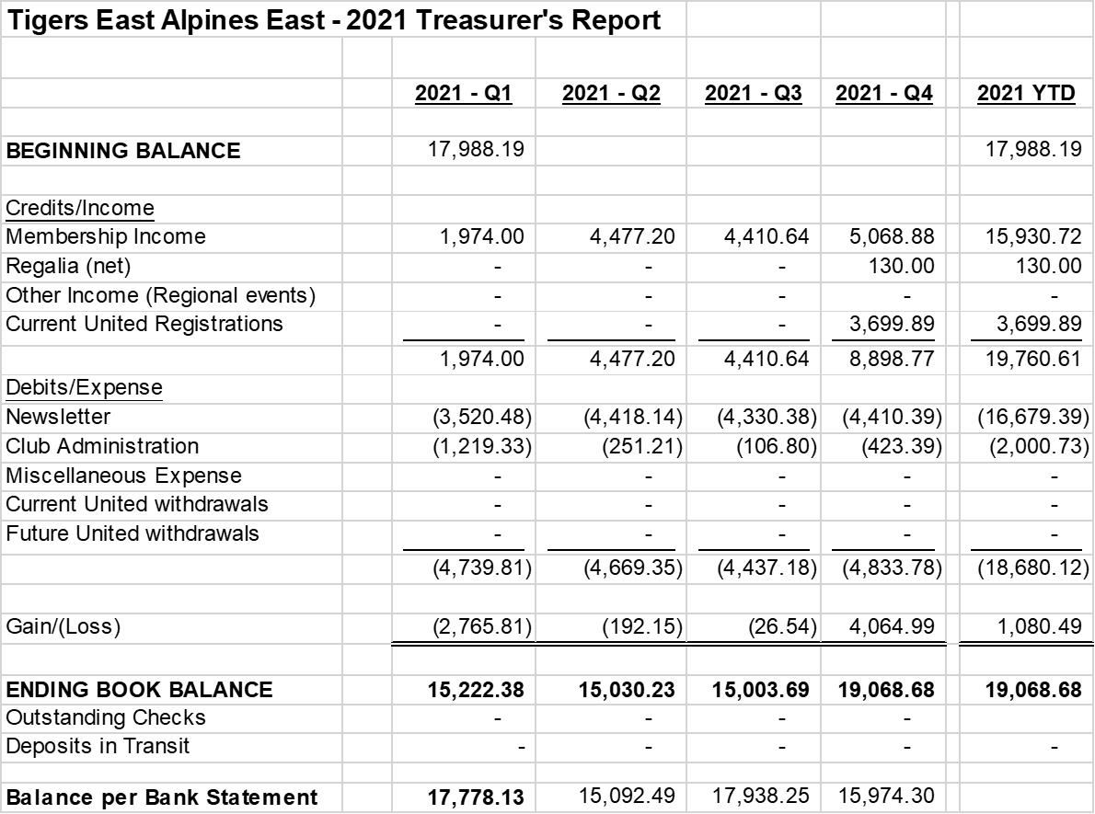
2021 Balance Sheet

Slide 38
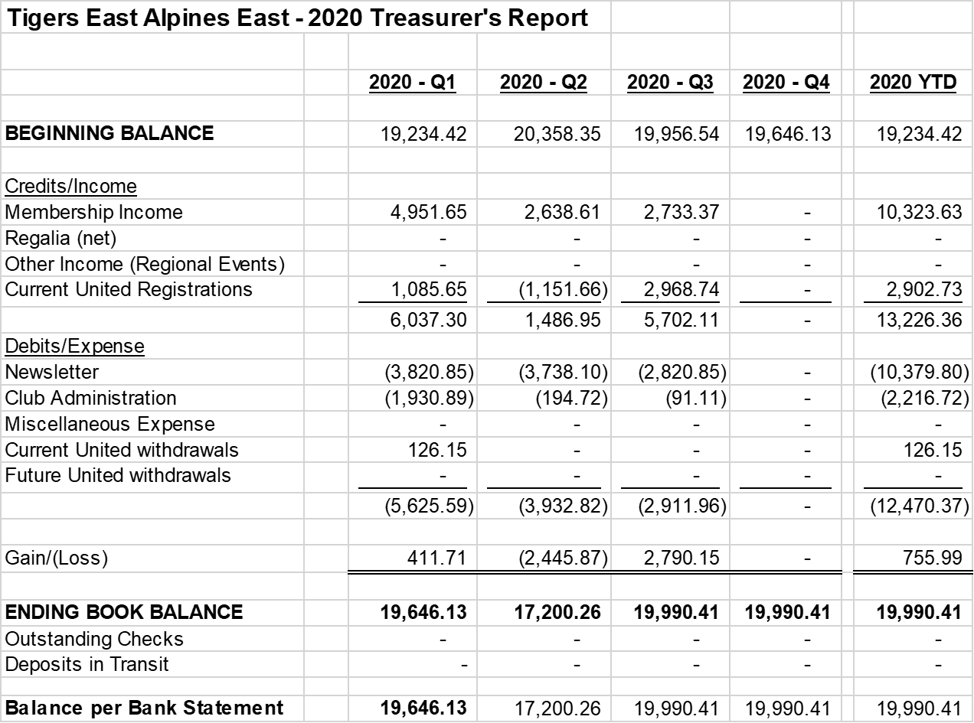

2020 Balance Sheet

Slide 39

2019 Balance Sheet

Slide 40
Annual Profit/Loss Comparison
2021 - $1,080.49 (would be roughly ($2,619.40) without SUNI profit)
2020 - $328.07 (would be roughly ($2,640.67) if we didn’t get United refund or United financials)
2019 – ($2,743.13)
2018 – ($1,878.22)
Negative Trend based on Membership vs. Newsletter, but Newsletter is “The Quality Product” wanted by all Members

