Slide 1
TEAE Board of Directors Annual Conference August 20, 2023

Slide 2
Agenda
Welcome
Roll Call
Reports
Old Business
New Business
Adjourn

Slide 3
Reports
Review and approval of February BoD Meeting Minutes
Treasurer’s Report
Membership Report
Website/Editor’s Report
Additional Reports as Required

Slide 4
Treasurer’s Report Steve Murphy

Slide 5
5 Year Summary
CY | 2018 | 2019 | 2020 | 2021 | 2022
Starting Balance | 22281 | 20553 | 17660 | 17988 | 19068
Ending Balance | 20553 | 19234 | 17873 | 15974 | 23061
Membership | 17090 | 15831 | 16158 | 15930 | 16398
Newsletter | 20447 | 20062 | 15708 | 16679 | 16298
 | -3357 | -4231 | 450 | -749 | 100
SUNI | 0 | 0 | 0 | 0 | 3699
United | 3057 | 7524 | 3096 | 0 | 4355
RAC Donations | 502 | 500 | 1200 | 0 | 0

Slide 6
Membership Report Joe McConlogue

Slide 7
Membership Breakdown as of July 31, 2023
519 members
Up 10 from last meeting
To date in 2023:
25 new members joined
29 memberships lapsed
Net change -4
Newsletter selection
196 electronic (incl 28 Canadian)
323 printed (incl 2 lifetime, 10 intl)
Change is 1.0% toward printed
Dues payment so far this year
30% pay by check
70% pay by credit card
Change is 2% toward credit cards
44% by PayPal and 56% by Stripe (14% change toward Stripe)
Misc Data
81 members who renewed to date (32%) use auto-renewal
20 members (4%) of total membership have not provided an email address

Slide 8
Membership
Now taking Stripe or checks only for dues
Mike Hartman helping to automate monthly tasks
There will be one more roster update before the United.

Slide 9
Membership Initiative
Contacted Jeff Eakin, President of Colorado Association of Tiger Owners (CATO)
CATO is a club in name only…more a loose collection of about 25 Tiger owners.
Attempted to convince him to have CATO become part of TEAE and become nucleus of Rocky Mountain Region
Offered a $5.00 discount on first year membership
CATO, after much internal discussion, declined the offer

Slide 10
Editor/Webmaster Report Kerch McConlogue

Slide 11
RootesReview
Month | No. of Pages | Monthly Cost
January | 12 | $ 1093
February | 12 | $ 1103
March | 12 | $ 1103
April | 20 | $ 1851
May | 12 | $1013
June | 20 | $1845
July | 12 | $1125
August | 12 | $ 1096
 | Avg pages per issue 14 | Total costs for First 8 months $10,229
September 2022 | 16 | $ 1560
October 2022 | 16 | $ 1563
November 2022 | 20 | $ 1829
December 2022 | 12 | $ 1091*
 | 2022 total
Continue to print every month but print every other month
Estimate cost 6 printed issues/year 12 published/year 2022 prices
Average pages | 32
Cost for 16 pages | $ 1,800
Annual cost for 6 issues | $ 10,800
* Mailed first class

Slide 12
Back Issue Requests
Based on $64 per page for a print run of 350 plus $200 for mail processing
pages | per copy | wt | postage* | Subtotal | price
12 | $ 2.77 | 2 oz | $ 0.83 | $ 3.60 | $ 4.00
16 | $ 3.50 | 2.6 oz | $ 1.03 | $ 4.53 | $ 5.00
20 | $ 4.23 | 3.4 oz | $ 1.23 | $ 5.46 | $ 6.00
24 | $ 4.96 | 4 oz | $ 1.23 | $ 6.19 | $ 6.50
* As of July 2023
Posted online here: https://www.teae.org/rootes-reviews/#printed
Notes:
64X12 = 768 +200 968 /350 =2.77/ COPY
Straight: 1096 (august) /350

Slide 13
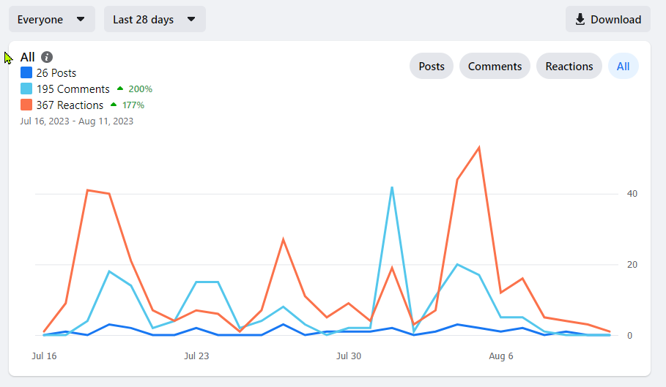
Facebook
Total membership 1387 (as of Aug 13)
Engagement for 28 days July 16-Aug 11

Slide 14
Visitors to the website Everything changed July 1 So I don’t know much
2.5K users since July 1
Average time on a page: 2 min 31 sec

Slide 15
Additional Reports Keep reports to 2 minutes

Slide 16
Old Business
Three Year Business Plan Committee
United 40 Update
United 41 Update

Slide 17
Three Year Business Plan (3YPC) Update
July 2022: Board approves the formation of a Three-Year Business Plan Committee (3YPC)
MISSION
Identify financially executable practices and procedures TEAE
should pursue to better serve the Rootes Marque in North
America. OBJECTIVES - Identify/list the club’s strengths, accomplishments - Identify the club’s weaknesses or needs - Identify opportunities & ideas to pursue - Identify risks, conflicts and threats PROCESS - Capture thoughts, ideas, opinions - Develop actionable opportunities & ideas to pursue - Develop actionable plan the BOD can execute

Slide 18
Three Year Business Plan (3YPC) Update
February 2023: The Board approved the following recommendations for action
A committee of members to improve participation and responsiveness of Facebook and Forum platforms.
A standing committee of members to produce technical videos.
A committee to make recommendations with regard to the Wally Smith and Keith Porter awards.
Review and possible revision of bylaws
An expansion of TAC activities by TEAE.
Preparation of a regalia plan including a plan for any seed money required.
A volunteer should be sought to investigate qualifications for 501 (c)3 tax status.
Approval to investigate options altering club logo & name to de-emphasize EAST and promote the inclusion of all Rootes Vehicles
Expansion and promotion of the BASH concept as tool for Regional Reps
Investigate ways to expand membership west of Mississippi

Slide 19
Three Year Business Plan (3YPC) Update
Forum/Facebook
Formed subcommittee (Jim Lindner/Kerch McConlogue/Steve Murphy/Kevin Klotzbach/Ron Stein/Gary Corbett) to identify and implement actions to improve useability and promote participation
Updated Forum categories. Eliminated stale topics
Added admins to both platforms to improve overall management
Outreach to members and other knowledgeable people in community. Invitation to join and/or participate on both platforms. This has improved responsiveness
FB continues to grow. Forum appears to be getting more use and responsiveness to posts has improved.

Slide 20
Three Year Business Plan (3YPC) Update
Revision of Legacy Award Criteria
Tiger Tom and Tom Calvert working on revisions
Results pending
Revision of Bylaws
Objectives
Remove procedural items and develop a separate Procedures Manual
Increase number of Board members to nine (9)
Drafts have been made and are currently being reviewed.
TAC Program Improvements
Tom C. and Bill Bulpitt working on improvements within TEAE.
Regalia
Jim Lindner investigated possibility of partnering with vendor who would maintain copies of our logo, take and fill individual orders for imprinted products and give TEAE small cut of profit
Vendor was unable/unwilling to do this. Advised that others would likely respond the same
Unless other ideas/options are presented recommend we table this initiative

Slide 21
Three Year Business Plan (3YPC) Update
Production of Technical Videos
No significant action to report
Expansion and Promotion of BASH concept by Regions
Regions were urged to adopt the BASH (Bring a Sunbeam Here) moniker when organizing and conducting gatherings at the local level, especially those built around a larger car show event.
Successful execution enables our national club to keep a local feel
Regional Reps in several Regions have done this with good results as reported in recent issues of Rootes Review
Expansion of membership west of the Mississippi
Rootes Review coverage helps promote western participation
Other considerations
Holding a United event west of Mississippi
BOD expansion should provide additional opportunities for western members to seek leadership positions within the club
Absorbing smaller Rootes Groups

Slide 22
Three Year Business Plan (3YPC) Update
Investigate qualifying for 501 (c) (3) status (Tax exempt non-profit organization)
Joe Montecalvo presented a general outline of the process. Appears little justification or support for this effort. Tiger Tom will continue to investigate options
Revision of Club logo
Focus is to deemphasize EAST and promote TEAE as a North American organization that includes ALL Rootes vehicles
Jim Lindner provided a few initial concepts
Kerch reaching out to graphic designer. Results pending
Recommend formation of working group to vet design concepts

Slide 23
DRAFT SUGGESTIONS

Slide 24
United 40 Bowling Green, KY
Dates: Sep 14-17, 2023
Current Registration
126 People
59 Cars
Well within budget…estimate $2.5k profit
Host Hotel: Holiday Inn University Plaza
Far exceeded our Guaranteed room block of 200 room nights. Rebate of $1K due. Should cover costs for Common rooms (hospitality, parts, banquet)
Tech Sessions??????
Volunteers??????

Slide 25
United 40
Planned Activities
Thursday:
Track time at National Corvette Museum MotorSports Park…20 participating
Friday: (Cost incl in Registration)
Scenic AM drive followed by Lunch and tour of National Corvette Museum (NCM)
Welcome Reception/General Membership Meeting
Saturday: (Cost incl in Registration)
Concours: Venue: Fenced in Grassy area adjacent hotel. Boxed lunch delivered to show field…59 Cars
Guest Speaker: Evening presentation. Tom Patton
Sunday: (Cost incl in Registration fee except Autocross)
Autocross: Piggyback on KYSCCA event. Separate registration thru Motorsportsreg.com $60/pp. 14 participants
Kart Racing: NCM Motorsports Park. 21 Participants
Lanes Auto Museum Nashville. 54 Participants
Mammoth Cave Tour. 24 Participants
Banquet (Brad Phillips MC tentative: trophies by Joe Parlanti)

Slide 26
United 41 (2024)
Location: West Lebanon, NH
Dates: August 15-18, 2024
Host Hotel: Fireside Inn West Lebanon, NH
Room Rate $129.95. Good three days before and after
Conveniently located at Intersection of I-91 & I-89
Planned Activities
Covered Bridge Scenic Tour followed by Lunch at Harpoon Brewery
Concours at Macs Maple Farm
Autocross will piggyback on NHSCCA event already scheduled for Sunday Aug 18, 2023
Alternate Sunday Activity: Mt. Ascutney Hill Climb followed by Tour of American Precision Museum
Discussion

Slide 27
New Business
2023 Elections
Positions up for election: President, Vice-President, Secretary, Treasurer and one Board position
President has reached term limit
Identify incumbents wishing to run again and accept nominations
Nominations from General Membership
At General Membership meeting
In writing to President
Candidate Bios published November RR 2023
Balloting commences with publication
Balloting closes December 15, 2023
Results announced January 2024

Slide 28
Wrap Up
Any other items to Discuss?
Motion to Adjourn

Slide 29
Backup Slides

Slide 30
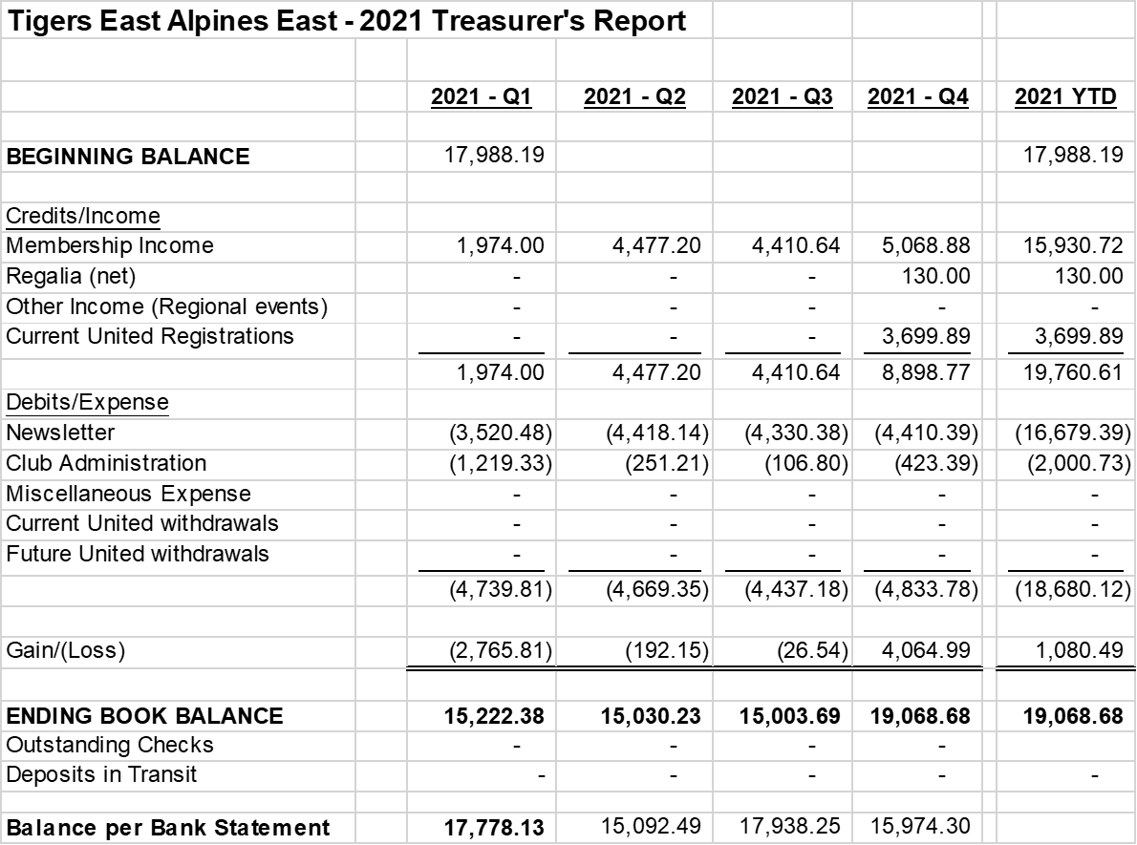
2021 Balance Sheet

Slide 31
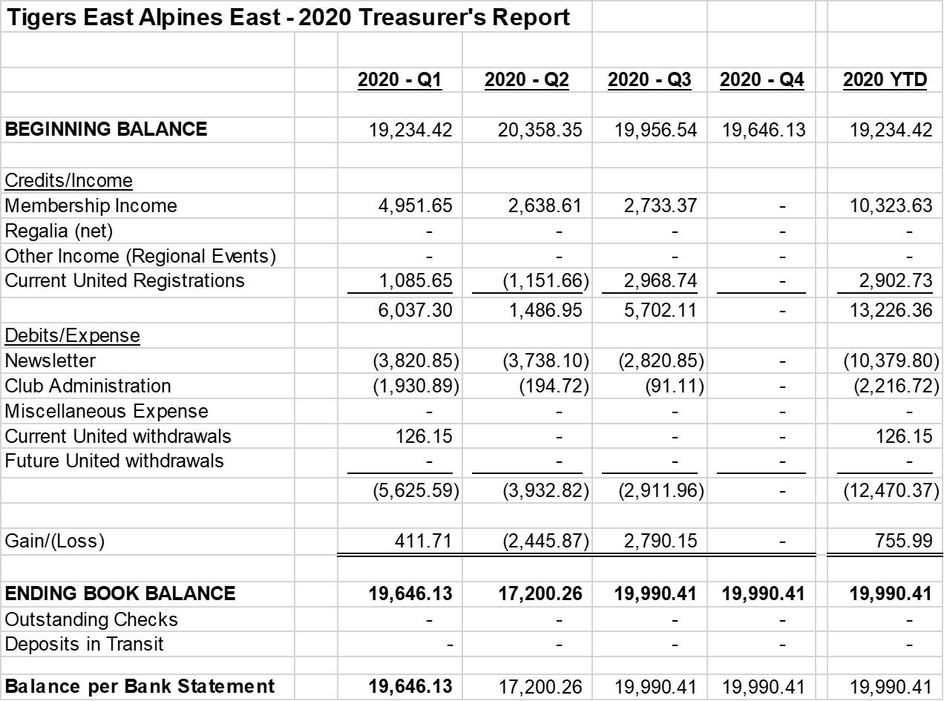
2020 Balance Sheet

Slide 32
2019 Balance Sheet

Slide 33
Redbubble.com 25% to the club – fee based on the profit for the month
https://help.redbubble.com/hc/en-us/articles/14947403598100-Artist-Account-Tiers-Fees
Notes:
Sell lone shirt for $15 x 25% to the club = 3.75 – fee of $1.45 = $2.30 to the club

