Slide 1

TEAE
General Membership Meeting
September 15, 2023

Slide 2
Agenda
Welcome
Roll Call
Reports
Old Business
New Business
Adjourn

Slide 3
Reports
Treasurer’s Report
Membership Report
Website/Editor’s Report
Additional Reports as Required

Slide 4
Treasurer’s Report
Steve Murphy

Slide 5
5 Year Summary
CY | 2019 | 2020 | 2021 | 2022 | 2023
Starting Balance | 20553 | 17660 | 17988 | 19068 | 23061
Ending Balance | 19234 | 17873 | 15974 | 23061 | 44516
Membership | 15831 | 16158 | 15930 | 16398 | 9662
Newsletter | 20062 | 15708 | 16679 | 16298 | 9692
 | -4231 | 450 | -749 | 100 | -30
SUNI | 0 | 0 | 0 | 3699 | 0
United | 7524 | 3096 | 0 | 4355 | 23684
RAC Donations | 500 | 1200 | 0 | 0 | 500

Slide 6
Membership Report
Joe McConlogue

Slide 7
Membership Breakdown as of July 31, 2023
519 members
  Up 10 from last meeting
  To date in 2023:
    25 new members joined
    29 memberships lapsed
    Net change -4
Newsletter selection
  196 electronic (incl 28 Canadian)
  323 printed (incl 2 lifetime, 10 intl)
  Change is 1.0% toward printed
Dues payment so far this year
  30% pay by check
  70% pay by credit card
  Change is 2% toward credit cards
    44% by PayPal and 56% by Stripe (14% change toward Stripe)
Misc Data
  81 members who renewed to date (32%) use auto-renewal
  20 members (4%) of total membership have not provided an email address

Slide 8
Membership
Now taking Stripe or checks only for dues
Mike Hartman helping to automate monthly tasks

Slide 9
Membership Initiative
Contacted Jeff Eakin, President of Colorado Association of Tiger Owners (CATO)
  CATO is a club in name only…more a loose collection of about 25 Tiger owners.
Attempted to convince him to have CATO become part of TEAE and become nucleus of Rocky Mountain Region
Offered a $5.00 discount on first year membership
CATO, after much internal discussion, declined the offer

Slide 10
Editor/Webmaster Report
Kerch McConlogue

Slide 11
RootesReview
Month | No. of Pages | Monthly Cost
January | 12 | $ 1093
February | 12 | $ 1103
March | 12 | $ 1103
April | 20 | $ 1851
May | 12 | $1013
June | 20 | $1845
July | 12 | $1125
August | 12 | $ 1125 (est)
 | Avg pages per issue 14 | Total costs for First 8 months $10,258
September 2022 | 16 | $ 1560
October 2022 | 16 | $ 1563
November 2022 | 20 | $ 1829
December 2022 | 12 | $ 1091*
 | 2022 total
Estimate cost 6 printed issues/year 12 published/year 2022 prices
Average pages | 32
Cost for 16 pages | $ 1,800
Annual cost for 6 issues | $ 10,800
* Mailed first class

Slide 12
Back Issue Requests
Based on $64 per page for a print run of 350
plus $200 for mail processing
  (It’s really more like $335 for postage and mail processing)
Reminder: Printed members don’t pay the full freight
pages | per copy | wt | postage* | Subtotal | price
12 | $ 2.77 | 2 oz | $ 0.83 | $ 3.60 | $ 4.00
16 | $ 3.50 | 2.6 oz | $ 1.03 | $ 4.53 | $ 5.00
20 | $ 4.23 | 3.4 oz | $ 1.23 | $ 5.46 | $ 6.00
24 | $ 4.96 | 4 oz | $ 1.23 | $ 6.19 | $ 6.50
* As of July 2023
Posted online here: https://www.teae.org/rootes-reviews/#printed

Slide 13
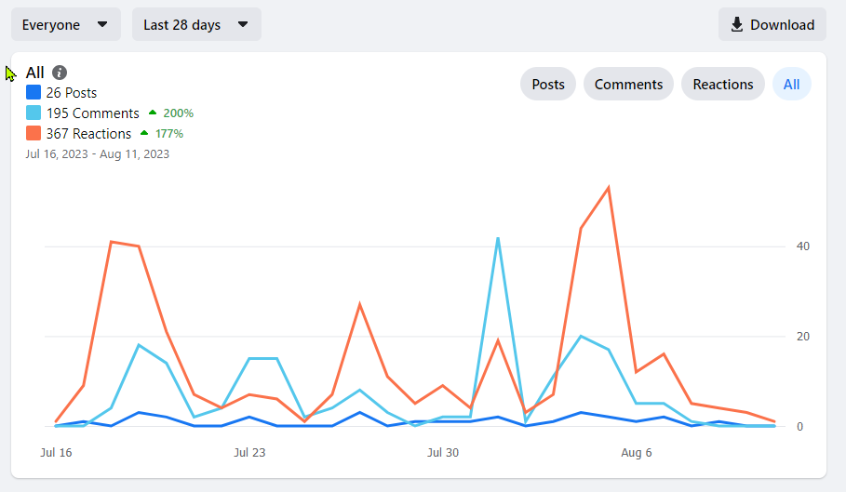
Facebook
Total membership 1387 (as of Aug 13)
Engagement for 28 days July 16-Aug 11

Slide 14
Visitors to the website
Everything changed July 1
So I don’t know much
2.5K users since July 1
Average time on a page: 2 min 31 sec

Slide 15
Old Business
Three Year Business Plan Committee

Slide 16
Three Year Business Plan (3YPC) Update
July 2022: Board approves the formation of a Three Year Business Plan Committee (3YPC)
  MISSION
  Identify financially executable practices and procedures TEAE
  should pursue to better serve the Rootes Marque in North
  America.
  OBJECTIVES
  - Identify/list the clubs strengths, accomplishments
  - Identify the clubs weaknesses or needs
  - Identify opportunities & ideas to pursue
  - Identify risks, conflicts and threats
  PROCESS
  - Capture thoughts, ideas, opinions
  - Develop actionable opportunities & ideas to pursue
  - Develop actionable plan the BOD can execute

Slide 17
Three Year Business Plan (3YPC) Update
February 2023: The Board approved the following recommendations for action
A committee of members to improve participation and responsiveness of Facebook and Forum platforms.
A standing committee of members to produce technical videos.
A committee to make recommendations with regard to the Wally Smith and Keith Porter awards.
Review and possible revision of bylaws
An expansion of TAC activities by TEAE.
Preparation of a regalia plan including a plan for any seed money required.
A volunteer should be sought to investigate qualifications for 501 (c)3 tax status.
Approval to investigate options altering club logo & name to de-emphasize EAST and promote the inclusion of all Rootes Vehicles
Expansion and promotion of the BASH concept as tool for Regional Reps
Investigate ways to expand membership west of Mississippi

Slide 18
Three Year Business Plan (3YPC) Update
Forum/Facebook
  Formed subcommittee (Jim Lindner/Kerch McConlogue/Steve Murphy/Kevin Klotzbach/Ron Stein/Gary Corbett) to identify and implement actions to improve useability and promote participation
  Updated Forum categories. Eliminated stale topics
  Added admins to both platforms to improve overall management
  Outreach to members and other knowledgeable people in community. Invitation to join and/or participate on both platforms. This has improved responsiveness
  FB continues to grow. Forum appears to be getting more use and responsiveness to posts has improved.

Slide 19
Three Year Business Plan (3YPC) Update
Revision of Legacy Award Criteria
  Tiger Tom and Tom Calvert working on revisions
  Results pending
Revision of Bylaws
  Objectives
    Remove procedural items and develop a separate Procedures Manual
    Increase number of Board members to nine (9)
  Drafts have been made and are currently being reviewed by Board
  Will eventually be presented to General Membership for approval
TAC Program Improvements
  Tom C. and Bill Bulpitt working on improvements within TEAE.
Regalia
  Jim Lindner investigated possibility of partnering with vendor who would maintain copies of our logo, take and fill individual orders for imprinted products and give TEAE small cut of profit
  Vendor was unable/unwilling to do this. Advised that others would likely respond the same
  Kerch has found a company that might be willing to do this. Results pending

Slide 20
Three Year Business Plan (3YPC) Update
Production of Technical Videos
  No significant action to report
  Need volunteer to take on this project
Expansion and Promotion of BASH concept by Regions
  Regions were urged to adopt the BASH (Bring a Sunbeam Here) moniker when organizing and conducting gatherings at the local level, especially those built around a larger car show event.
  Successful execution enables our national club to keep a local feel
  Regional Reps in several Regions have done this with good results as reported in recent issues of Rootes Review
Expansion of membership west of the Mississippi
  Rootes Review regional coverage helps promote western participation
  Other considerations
    Holding a United event west of Mississippi
    BOD expansion should provide additional opportunities for western members to seek leadership positions within the club
    Absorbing smaller Rootes Groups

Slide 21
Three Year Business Plan (3YPC) Update
Investigate qualifying for 501 (c) (3) status (Tax exempt non-profit organization)
  Joe Montecalvo presented a general outline of the process. Appears little justification or support for this effort. Tiger Tom will continue to investigate options
Revision of Club logo
  Focus is to deemphasize EAST and promote TEAE as a North American organization that includes ALL Rootes vehicles
  Jim Lindner provided a few initial concepts
  Kerch reaching out to graphic designer. Results pending

Slide 22
New Business
2023 Elections
  Positions up for election: President, Vice-President, Secretary, Treasurer and one Board position
    All incumbents except President have volunteered to serve again and have been nominated
    President has reached term limit
  Nominations from General Membership
    Floor is open for nominations
    In writing to President
  Candidate Bios published Oct 2023
  Balloting commences November 1. 2023
  Balloting closes December 15, 2023
  Results announced January 2024

Slide 23

TEAE UNITED 2024

Slide 24
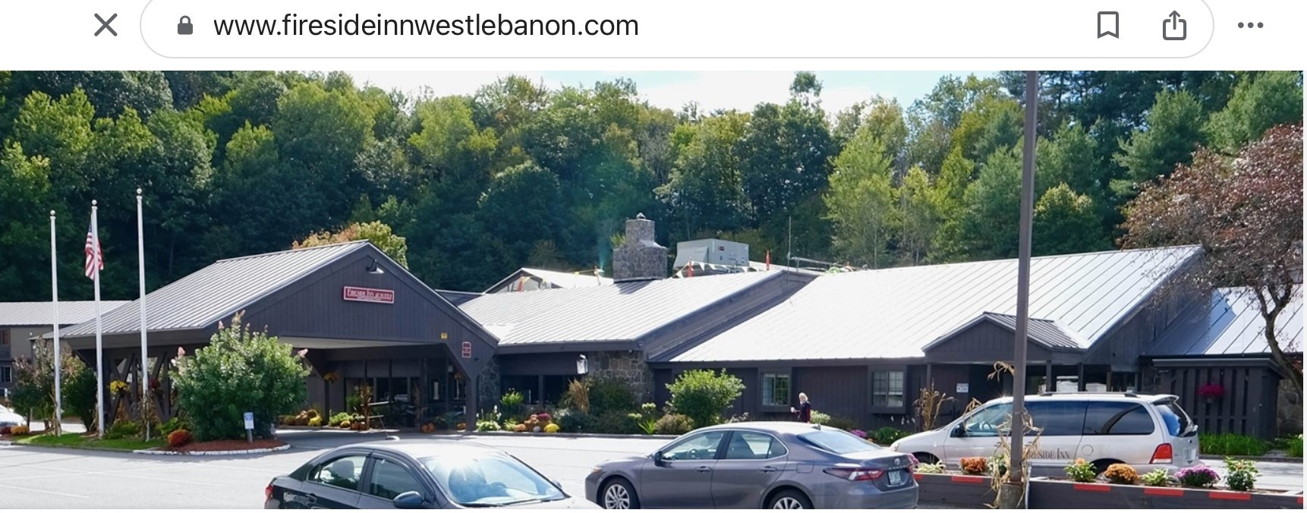
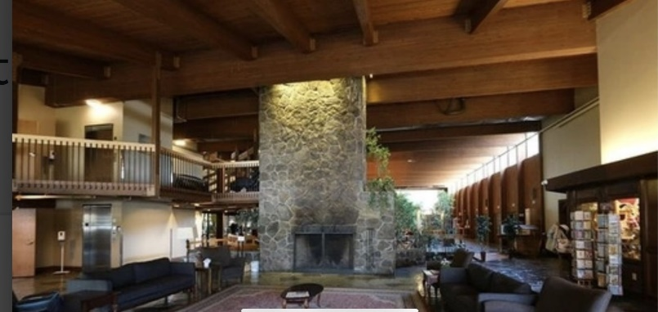
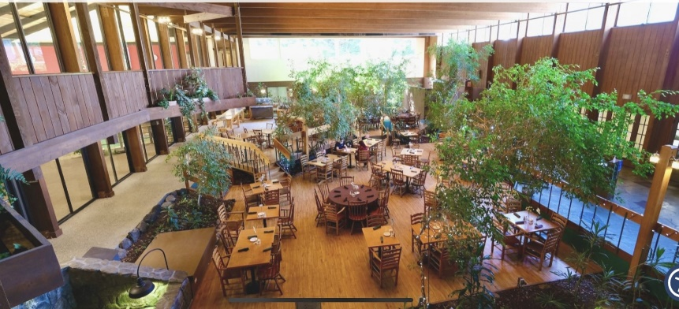
United 41 (2024)
Location: West Lebanon, NH
Dates: August 15-18, 2024
Host Hotel: Fireside Inn West Lebanon, NH
  Room Rate $129.95. Good three days before and after
  Conveniently located at Intersection of I-91 & I-89

Slide 25
United 41 (2024)
Planned Activities
  Covered Bridge Scenic Tour followed by Lunch at Harpoon Brewery
  Concours at Macs Maple Farm

Slide 26
United 41 (2024)
  Autocross will piggyback on NHSCCA event already scheduled for Sunday Aug 18, 2023 at Canaan Motor Club
  Alternate Sunday Activity: Mt. Ascutney Hill Climb followed by Tour of American Precision Museum
Discussion

Slide 27
Wrap Up
Any other items to Discuss?
Motion to Adjourn

Slide 28
Backup Slides

Slide 29
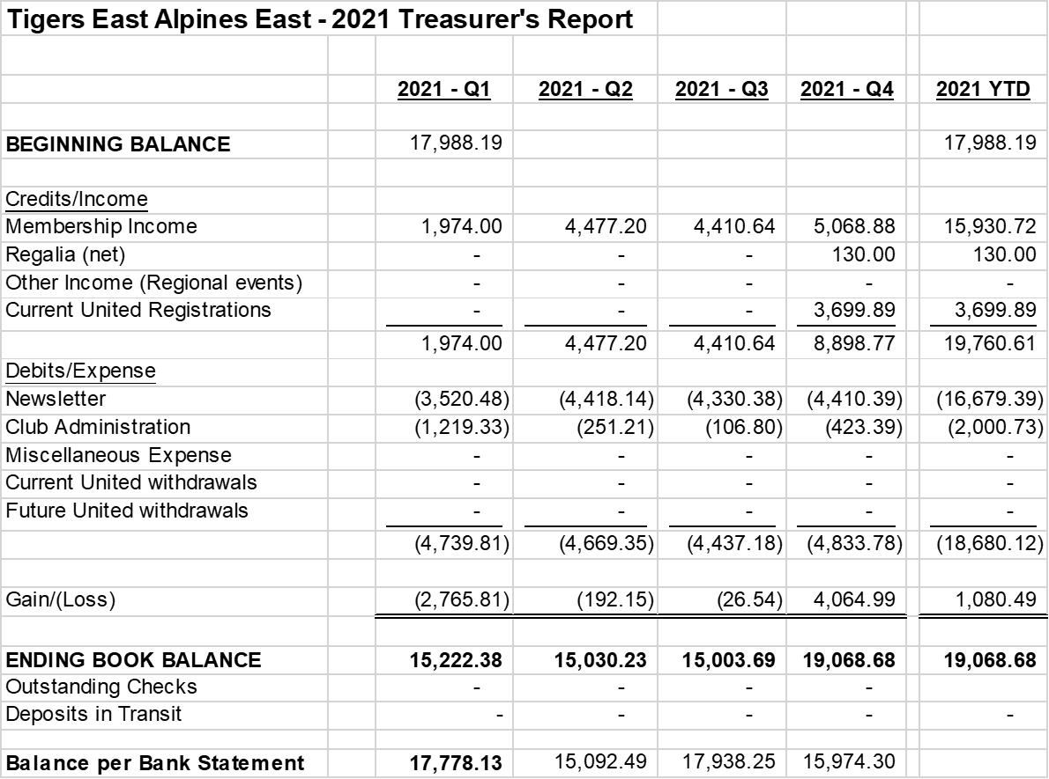
2021 Balance Sheet

Slide 30
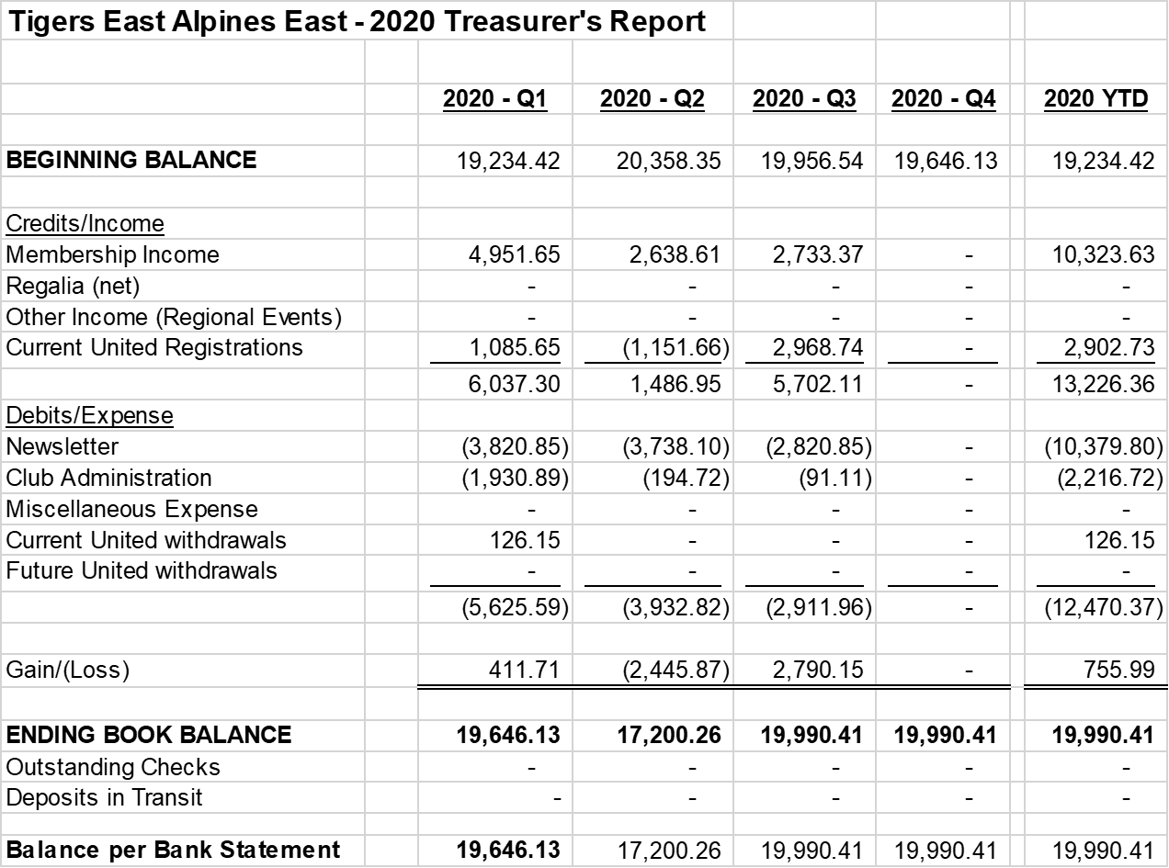

2020 Balance Sheet

Slide 31

2019 Balance Sheet

