Slide 1

TEAE Board of Directors
Semi-Annual Conference
March 2, 2024

Slide 2
Agenda
Welcome
Roll Call
Reports
Old Business
New Business
Adjourn

Slide 3
Reports
Review and approval of August BoD Meeting Minutes
Treasurer’s Report
Membership Report
Website/Editor’s Report
Additional Reports as Required

Slide 4
Treasurer’s Report
Steve Murphy

Slide 5
5 Year Summary
CY | 2018 | 2019 | 2020 | 2021 | 2022
Starting Balance | 22281 | 20403 | 17660 | 17988 | 19068
Ending Balance | 2040 | 17660 | 17988 | 19068 | 23061
Membership | 17090 | 15831 | 16158 | 15930 | 16398
Newsletter | 20447 | 20062 | 15708 | 16679 | 16298
 | -3357 | -4231 | 450 | -749 | 100
SUNI | 0 | 0 | 0 | 0 | 3699
United | 3057 | 7524 | 3096 | 0 | 4355
RAC Donations | 502 | 500 | 1200 | 0 | 0
$s Verified – Clerical Error
Thanks for letting me be Treasurer for 5 years,
We welcome: Steve Murphy

Slide 6
TEAE Account Balance Sheet
Jan 1-Dec 31, 2023
Starting Balance NFCU 1/1/2023 $23,601
INCOME
  Dues - Electronic Newsletter 5,775.84
  Dues - Paper Newsletter ` 10.657.54
  Interest Inc 8.48
  United 40 Registration Fee 27,281.11
  Transfer From Steve M Checking 390
  TOTAL INCOME 44,112.97
EXPENSES (From 4/1/2023)
  United 40 Expenses (20,264.09)
  Bank Fee (59.38)
  Liability Insurance (916)
  Postage (172.42)
  Print Services (18,426)
  Web Hosting (427.08)
  Transfer To Steve M Checking (164.06)
  TOTAL EXPENSES (40,429.03)
  Profit/Loss $3,683.94
Ending Balance 12/31/2023 $27,284.94

Slide 7
Membership Report
Joe McConlogue

Slide 8
Membership Breakdown as of December 31, 2023
521 members
  Membership changes 2023:
    38 new members joined
    46 memberships lapsed
    Net change -8
Newsletter selection
  205 electronic (incl 26 Canadian) – 39%
  316 printed (incl 2 lifetime, 8 intl) – 61%
  No change from split last year
Dues payment 2023
  29% paid by check
  71% paid by credit card
  Change is 1% toward credit cards
    63% of credit cards by Stripe and 37% by PayPal (legacy subscriptions)
Misc Data
  233 members use auto-renewal (subscription)
  20 members have not provided an email address (no change)

Slide 9
Membership
Now taking Stripe or checks only for dues
One US member selected the Canadian level – to prevent a recurrence code was added to the membership software. Kerch can explain what happened next.
Mike Hartman is helping to automate monthly tasks
A certain amount of handholding still required:
  Members move and don’t update their address – find out by returned mailing (pay postage due for returned RR)
  Emails change and don’t update – find out by bounced emails – send postcard
  Credit cards expire – payments fail
  Expiration date notices are ignored requiring follow-up.

Slide 10
Editor/Webmaster Report
Kerch McConlogue

Slide 11
RootesReview
Month | Pages | Cost | /page
January | 12 | $1,093 | $91
February | 12 | $1,103 | $92
March | 12 | $1,103 | $92
April | 20 | $1,851 | $93
May | 12 | $1,013 | $84
June | 20 | $1,845 | $92
July | 12 | $1,125 | $94
August | 12 | $1,096 | $91
Sept | 12 | $1,096 | $91
Oct | 16 | $1,580 | $99
Nov | 16 | $1,602 | $100
Dec | 12 | $1,098 | $92
Jan/Feb 2024 | 16 | $1,583 | $99
Average | 14 | $1238 | $93
Continue to print every month
but print every other month
Cost for 6 printed issues/year vs 12 published/year
Cost | monthly | annual | savings
16 pages | $1175 | $14,100
24 pages | $1563 | $9378 | $4,722
28 pages | $1735 | $10518 | $3,582
32 pages | $1904 | $11,424 | $2,676
Notes:
Just some info and thought from the printer
A lot of our clients have come back to hard printing after going to electronic, seems like a lot of people do not want to read newsletters on their phones or even view them on their computers as they would have to print out if needed, About 80% of people will not print out hard copy on their home printers and then then clubs loose members due to no communications. We have experiences this in the last few years.
Here is current pricing as of today February 27th, 2024. Prices are always subject to change per consumable and paper pricing.
Printing and Mailing Prep:
Based on around 325 copies
12 pages-$895.00 or $74.58 per page plus $138.68 for postage as this page count can be folded down to a letter size rate for postage reduction.
16 pages-$1,175.00 or $73.44 per page plus $326.26 for postage as this page count has to mail as a flat rate, if we fold down to half size it will no process as its too thick for the USPS guide.
24 pages-$1,563.00 or $65.13 per page plus $326.26 postage
28 pages-$1,735.00 or $61.97 per page plus $326.26 postage
32 pages at $1,904.00 or $59.50 per page plus the $326.26 for postage
The postage rate will stay the same up to 32 pages give or take the rates and PO increases and regulations. That weight is 3.3 oz per each pc weight.
As of January 2024 all mail that is processed using a permit is required to prepare all paperwork online, there is no more hand written paper work any longer.
Please remember that all prices include all mailing prep which is- Tabbing, NCOA mail list per USPS regulations, jet address names, sort, tray, and deliver to Hbg PO.
Also please remember that we invoice the club for postage as other printers will need postage before the newsletters drop at PO. We have done this as Rootes has been a standing client with DRS for many ,many years.
If you like me to discuss to the board I would be willing to meet with any or all of them anytime.
Thank you,
Dan
Daniel R. Snyder
Owner/CEO

Slide 12
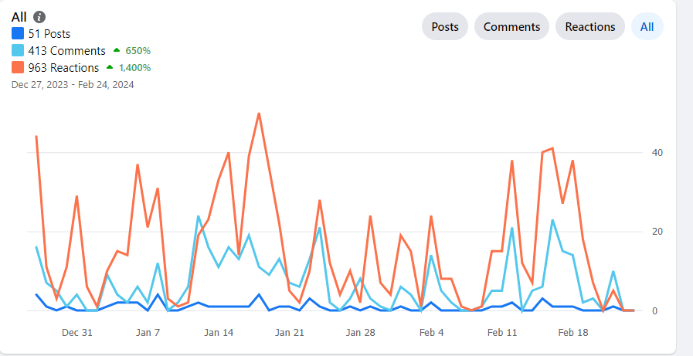
Facebook
Currently 1.7 membership
August 1.3 membership
Increase in six months of ~400 members
Engagement
December 27 to February 24
Engagement for 28 days July 16-Aug 11

Slide 13
Visitors to the website since Aug 1
Total 31,431 views
Average time on a page: 1 min 56 sec
About 30% started their visit on the home page
6% landed on carburetor identification
4% landed on the forums
Notes:
Averaging time on a page is down a little bit from 2 minutes 31 seconds to now just one minute 56 seconds

Slide 14
Additional Reports
Keep reports to 2 minutes

Slide 15
Old Business
Three Year Business Plan Committee
United 41 Update

Slide 16
Three Year Business Plan (3YPC) Update
July 2022: Board approves the formation of a Three Year Business Plan Committee (3YPC)
  MISSION
  Identify financially executable practices and procedures TEAE
  should pursue to better serve the Rootes Marque in North
  America.
  OBJECTIVES
  - Identify/list the clubs strengths, accomplishments
  - Identify the clubs weaknesses or needs
  - Identify opportunities & ideas to pursue
  - Identify risks, conflicts and threats
  PROCESS
  - Capture thoughts, ideas, opinions
  - Develop actionable opportunities & ideas to pursue
  - Develop actionable plan the BOD can execute

Slide 17
Three Year Business Plan (3YPC) Update
February 2023: The Board approved the following recommendations for action
A committee of members to improve participation and responsiveness of Facebook and Forum platforms.
A standing committee of members to produce technical videos.
A committee to make recommendations with regard to the Wally Smith and Keith Porter awards.
Review and possible revision of bylaws
An expansion of TAC activities by TEAE.
Preparation of a regalia plan including a plan for any seed money required.
A volunteer should be sought to investigate qualifications for 501 (c)3 tax status.
Approval to investigate options altering club logo & name to de-emphasize EAST and promote the inclusion of all Rootes Vehicles
Expansion and promotion of the BASH concept as tool for Regional Reps
Investigate ways to expand membership west of Mississippi

Slide 18
Three Year Business Plan (3YPC) Update
Forum/Facebook
  Updated Forum categories. Eliminated stale topics
  Added admins to both platforms
  Outreach to members and other knowledgeable people in community. Invitation to join and/or participate on both platforms.
  FB continues to grow. Forum appears to be getting more use and responsiveness to posts has improved.
  Action Complete. Continue maintenance.

Slide 19
Three Year Business Plan (3YPC) Update
Revision of Legacy Award Criteria (Tiger Tom & Tom C)
  Draft revisions retain original focus on autocross but add provision for substitute of “other competitive driving event” if an autocross is not held as part of a United.”
  Discussion, Motion, Vote
Revision of Bylaws
  Objectives
    Remove procedural items and develop a separate Procedures Manual
    Increase number of Board members to nine (9)
  Latest draft sent out.
  Discussion/Motion/VOTE
TAC Program Improvements
  Propose we establish a TAC link on website
    Explains the program
    Provides info to request TAC
  Designate TAC Coordinator for club
    Candidate would be current TAC inspector
    Reduce current burden on Tom C and Bill B. They concur
    Coordinator works with members/owners to schedule inspections
    Try to be proactive...not just reactive in scheduling
    Advertise scheduled inspections in Rootes Review

Slide 20
Three Year Business Plan (3YPC) Update
Regalia
Objective: Print on demand companies that will produce and ship items with our artwork and pay the club a percentage.
Kerch looked into:
  Printful.com and Teelaunch.com: both require a store to be set up on our website. But production and fulfillment is handled by the company
  Amazon is too expensive with ~$40 a month plus per product sale fee
  Society6.com: Similar setup to RedBubble.com but more artsy and no car products
Redbubble.com provides the best match for our needs.

Slide 21
Three Year Business Plan (3YPC) Update
Advantages of RedBubble.com
  Large number of products available
  Including: Mugs, coasters, T-shirts, sweatshirts, mouse pads, phone cases, aprons, duffle bags, tote bags
  They do total fulfillment of the products
  Large audience base (not just our club members)
  No “store” is required on our site
  Reasonable retail prices ( tend to be between a couple of bucks and $35 or $40)
  Fees paid on schedule
Disadvantages:
  All Redbubble products are screen printed not embroidered
  If we want to provide higher quality embroidered jackets and hats, we would use a different company (perhaps Land’s End)
 | base cost | + markup | margin | retail price | Red bubble fee* | Red bubble fee** |  | Net to TEAE
 |  |  |  | Plus shipping/tax | From chart | Calculated% of margin
t shirt | $18.00 | 25% | $4.50 | $22.50 | $1.90 | 11.6% |  | $2.60
mug | $14.75 | 20% | $2.95 | $17.77 | $1.30 | 9.3% |  | $1.65
Fee table: https://help.redbubble.com/hc/en-us/articles/202270799-How-is-my-payment-calculated
Sample product retail costs including sample markup: https://www.redbubble.com/account/pricing

Slide 22
Three Year Business Plan (3YPC) Update
Production of Technical Videos
  No volunteers. No significant action to report
  Unless volunteer is identified to take on this project, recommend this action be closed
Expansion and Promotion of BASH concept by Regions
  Regions were urged to adopt the BASH (Bring a Sunbeam Here) moniker when organizing and conducting gatherings at the local level, especially those built around a larger car show event.
  Regional Reps in several Regions have done this with good results as reported in recent issues of Rootes Review
  Action Complete. Continue to promote BASH
Expansion of membership west of the Mississippi
  Continue Rootes Review coverage to promote western participation
  Other considerations
    Attempt to Absorb CATO failed. Plan to re-engage
    BOD expansion should provide additional opportunities for western members to seek leadership positions within the club
    Holding a United event west of Mississippi…Hold discussion for United 42 discussion under new business

Slide 23

Three Year Business Plan (3YPC) Update
Revision of Club logo
  Revised Logo complete.
  Cost $500 for graphic design services
Use of Badge or Landscape configuration dependent of application
Motion to approve? Vote. Approval includes payment for services.

Slide 24
Three Year Business Plan (3YPC) Update
Investigate qualifying for 501 (c) (3) status (Tax exempt non-profit organization)
  Joe Montecalvo presented a general outline of the process. Appears little justification or support for this effort.
  No real benefit to the club…action complete
  Recommend this item be closed

Slide 25
United 41
Location: West Lebanon, NH
Dates: August 15-18, 2024
Host Hotel: Fireside Inn West Lebanon, NH
  Room Rate $129.95. Good three days before and after
  Conveniently located at Intersection of I-91 & I-89
Registration fees:
  Early: $185 single/$350 two adults
  Late (Jul 1st): $200/$375

Slide 26
United 41
Planned Activities (included in registration fee except Autocross)
  Large Parts Room/Hospitality in 1st Floor Guest Room
  Friday Covered Bridge Scenic Tour followed by Lunch at Harpoon Brewery
  Friday eve Welcome Reception
  Saturday Concours at Macs Maple Farm. Lunch included
  Guest Speaker: Richard Langworth, automotive author
  Tiger documentary screening (pending)
  Sunday Autocross will piggyback on NHSCCA event already scheduled for Sunday Aug 18, 2023
  Alternate Sunday Activity: Mt. Ascutney Hill Climb followed by Tour of American Precision Museum
    Still considering best way to split into two groups
Budget

Slide 28
New Business
2024 Elections
  We need to start looking for candidates NOW
    Do we need to form committee to identify candidates and report at the Summer meeting.

Slide 29
Donation to TEAE
Recently advised of pending donation to club.
Ron Estes, longtime member has stipulated in his will that his Sunbeam Tiger MkIA be donated to the club.
Car is a decent personalized driver with 289 swap. It is located in MD. Original engine accompanies car.
Ron has advised that disposition of car is totally at our discretion…including sale.
My initial research did not reveal any legalities which would prevent the club from accepting.
  Since Ron is a member income realized is within 501 (c) 3 limits
Discussion: Hopefully, the actual donation will not happen for years but…
  How do we title?
  Where do we store/how do we maintain?
  Disposition options?

Slide 30
United 42 (2025)
Need to identify venue by this summer
Recap of recent venues
  North (Canada & NH) in 2022 & 2024.
  Midwest (WI, KY and SUNI) in 2021, 2019 & 2023
Due to return to Mid-Atlantic or South in 2025
  Search for Florida venue in 2023 was unsuccessful
  Poconos area? (Last PA United-2008)
  New Jersey? (We have NEVER held a United in NJ)
  Carolinas?
    Western NC (or VA)
    Coastal
    Greensboro (cancelled 2020 venue)
Do we cross the Mississippi?
Discussion

Slide 31
SUNI VIII (2026)
Contacted by Claudia Trippel from CAT. They have started to do some initial planning and wanted to know if TEAE has interest in participating/organizing
Early venue candidates focus on same general location as SUNI VII…slightly favors east coast
  Springfield, MO
  Joplin, MO
  Galeena, KS
Financial risks and gains shared among participating clubs same as SUNI VII
Final decision will require a Board vote, but can we agree in principle pending final details?
DISCUSSION

Slide 32
Wrap Up
Any other items to Discuss?
Motion to Adjourn

Slide 33
Backup Slides

Slide 34
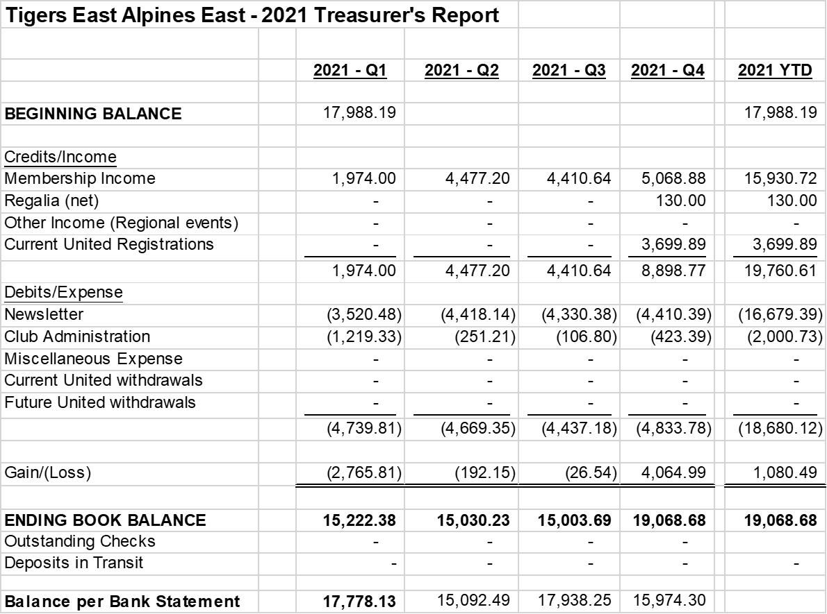
2021 Balance Sheet

Slide 35
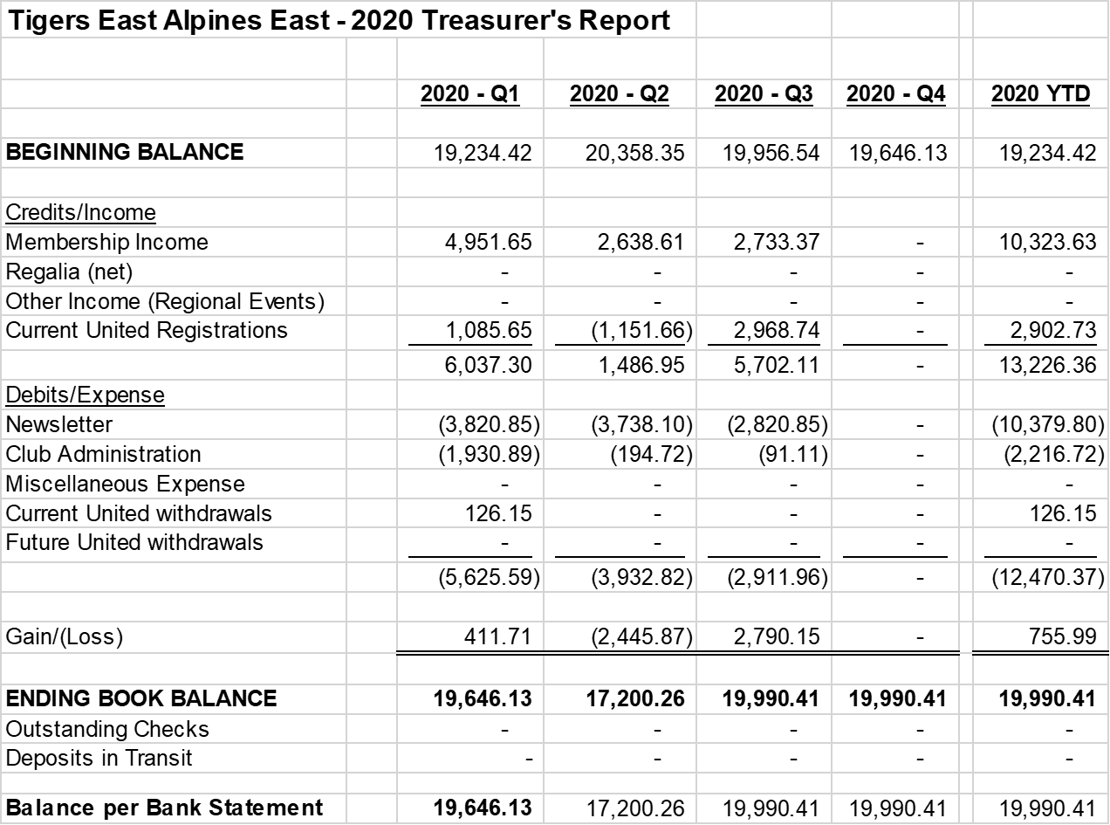

2020 Balance Sheet

Slide 36

2019 Balance Sheet

