Slide 1
TEAE Board of Directors Annual Conference July 2024

Slide 2
Agenda
Welcome
Roll Call
Reports
Old Business
New Business
Adjourn

Slide 3
Reports
Review and approval of February BoD Meeting Minutes
Treasurer’s Report
Membership Report
Website/Editor’s Report
Additional Reports as Required

Slide 4
Treasurer’s Report Steve Murphy

Slide 5
TEAE Account Balance Sheet Jan 1-June 30, 2024
Starting Balance 1/1/2023 $27,284.94
INCOME
Dues - Electronic Newsletter 1,879.72
Dues - Paper Newsletter ` 5,198.95
Interest Inc 1.55
United 41 Registration Fee 18,025.57
TOTAL INCOME 25,105.79
EXPENSES (From 6/1/2024)
United 41 Expenses (1,539.02)
Bank Fee (10.00)
Postage (62.90)
Print Services (4,756.90)
State Corp. Commission (25.00)
TOTAL EXPENSES (6,393.82)
Profit/Loss $18,711.97
Ending Balance 6/30/2024 $45,996.97

Slide 6
Membership Report Joe McConlogue

Slide 7
Membership Breakdown as of June 30, 2024
521 memberships / 783 members
Membership changes YTD:
20 new members joined
24 memberships lapsed
Net change -4
Newsletter selection
217 electronic (incl 26 Canadian) – 42%
304 printed (incl 2 lifetime, 9 intl) – 58%
3% change toward electronic
Dues payment YTD
33% paid by check
68% paid by credit card
Change is 3% toward checks (prob due to software issue)
71% of credit cards by Stripe and 29% by PayPal (legacy subscriptions)
Misc Data
234 members (45%) use auto-renewal (subscription)
18 members (3.5%) have not provided an email address
In the last broadcast email 6 members (1%) emails could not be delivered

Slide 8
Editor/Webmaster Report Kerch McConlogue

Slide 9
RootesReview
Jan 24 – July 24
Month | Pages | Cost
Jan/Feb | 16 | $1583
March | 12 | $1087
April | 12 | $1086
May | 12 | $1079
June | 20 | $1,758
July | 20 | $1079
August 23 | 12 | $1,096
Sept 23 | 12 | $1,096
Oct 23 | 16 | $1,580
Nov 23 | 16 | $1,602
Dec 23 | 12 | $1,098
Averages | 6 mos | 12 mos
Pages | 15.3 | 14.5
Cost | $ 1285 | $ 1278
Notes:
Just some info and thought:
A lot of our clients have come back to hard printing after going to electronic, seems like a lot of people do not want to read newsletters on their phones or even view them on their computers as they would have to print out if needed, About 80% of people will not print out hard copy on their home printers and then then clubs loose members due to no communications. We have experiences this in the last few years.
Here is current pricing as of today February 27th, 2024. Prices are always subject to change per consumable and paper pricing.
Printing and Mailing Prep:
Based on around 325 copies
12 pages-$895.00 or $74.58 per page plus $138.68 for postage as this page count can be folded down to a letter size rate for postage reduction.
16 pages-$1,175.00 or $73.44 per page plus $326.26 for postage as this page count has to mail as a flat rate, if we fold down to half size it will no process as its too thick for the USPS guide.
24 pages-$1,563.00 or $65.13 per page plus $326.26 postage
28 pages-$1,735.00 or $61.97 per page plus $326.26 postage
32 pages at $1,904.00 or $59.50 per page plus the $326.26 for postage
The postage rate will stay the same up to 32 pages give or take the rates and PO increases and regulations. That weight is 3.3 oz per each pc weight.
As of January 2024 all mail that is processed using a permit is required to prepare all paperwork online, there is no more hand written paper work any longer.
Please remember that all prices include all mailing prep which is- Tabbing, NCOA mail list per USPS regulations, jet address names, sort, tray, and deliver to Hbg PO.
Also please remember that we invoice the club for postage as other printers will need postage before the newsletters drop at PO. We have done this as Rootes has been a standing client with DRS for many ,many years.
If you like me to discuss to the board I would be willing to meet with any or all of them anytime.
Thank you,
Dan
Daniel R. Snyder
Owner/CEO

Slide 10
Bios in RootesReview
Because there are so many people running for positions, I’d like to keep the bios at a reasonable length.
Fill out the form here:
https://www.teae.org/bios-for-elections/

Slide 11
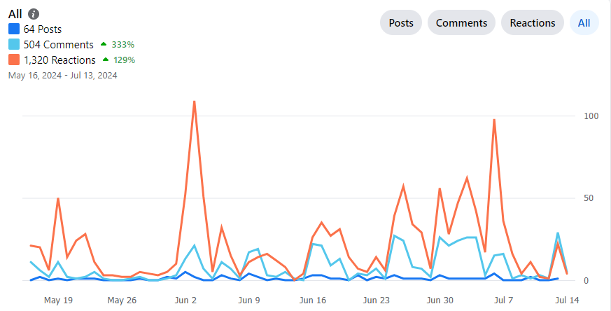
Facebook
Engagement for 60 days May 16- Jul 13
Currently 1.8K membership
August 1.3 membership
102 joined in last 60 days
Notes:
Insights | growth gives numbers

Slide 12
Visitors to the website since May 16
3863 visitors
Total 11,115 views
Average session duration: 5:22 minutes
About 19% started their visit on the home page
12% landed on carburetor identification
6% landed on the forums TOC (lists recent posts) or category pages
Mostly people look at one page and then bounce
Notes:
Averaging time on a page is down a little bit from 2 minutes 31 seconds to now just one minute 56 seconds

Slide 13
Additional Reports Keep reports to 2 minutes

Slide 14
Old Business
Three Year Business Plan Committee
2024 Elections
United 41 Update
United 42 Update
SUNI VIII Update

Slide 15
Three Year Business Plan (3YPC) Update
July 2022: Board approves the formation of a Three-Year Business Plan Committee (3YPC)
February 2023: The Board approved the following recommendations for action
A committee of members to improve participation and responsiveness of Facebook and Forum platforms.
A standing committee of members to produce technical videos.
A committee to make recommendations with regard to the Wally Smith and Keith Porter awards.
Review and possible revision of bylaws
An expansion of TAC activities by TEAE.
Preparation of a regalia plan including a plan for any seed money required.
A volunteer should be sought to investigate qualifications for 501 (c)3 tax status.
Approval to investigate options altering club logo & name to de-emphasize EAST and promote the inclusion of all Rootes Vehicles
Expansion and promotion of the BASH concept as tool for Regional Reps
Investigate ways to expand membership west of Mississippi

Slide 16
Three Year Business Plan (3YPC) Update Remaining Initiatives
Revision of Bylaws
Objectives
Remove procedural items and develop a separate Procedures Manual
Increase number of Board members to nine (9)
Approved by Board. Pending vote by General Membership at United
TAC Program Improvements
Propose we establish a TAC link on website
Explains the program
Provides info to request TAC
Designate TAC Coordinator for club
Candidate would be current TAC inspector
Reduce current burden on Tom C and Bill B. They concur
Coordinator works with members/owners to schedule inspections
Try to be proactive...not just reactive in scheduling
Advertise scheduled inspections in Rootes Review
Action Pending

Slide 17
Three Year Business Plan (3YPC) Update Remaining Initiatives
Regalia
Objective: Print on demand companies that will produce and ship items with our artwork and pay the club a percentage.
Redbubble.com determined to be the best match for our needs.
Kerch currently working the issue

Slide 18
2024 Elections
Positions up for election: President, Vice-President, Secretary, Treasurer and five Board positions including two positions expected to be approved with revision of bylaws
President has reached term limit
Vice-President has declined to serve again
Incumbents volunteering to run again?
Gary Corbett: Secretary
Steve Murphy: Treasurer
Eric Gibeaut, Tom Ehrhart & Tom Calvert: Board of Directors
Call for other nominations
Nominations from General Membership
At General Membership meeting
In writing to President or Membership Chair NLT Sep 15, 2024
Candidate Bios published Oct 2024
Balloting commences November 1. 2024
Balloting closes December 15, 2024
Results announced January 2025

Slide 19
United 41
Location: West Lebanon, NH
Dates: August 15-18, 2024
Host Hotel: Fireside Inn West Lebanon, NH
Registration fees:
Early: $185 single/$350 two adults
Late (Jul 1st): $200/$375
Tiger 60 Documentary Showing Confirmed
Robert Meeting with Hotel to confirm AV support
As of July 15th
95 People and 48 Cars

Slide 20
United 42 (2025)
Charlotte, NC is proposed venue
Dates: September 18-21, 2025
Host hotel: Embassy Suites Concord-Charlotte
$139/night room rate. Includes Breakfast. Good before & after
Excellent facility: Best we have stayed at in recent years
Reserved Parking close to side entrance for 50 cars
Reserved parking for trailers
Excellent Function rooms
Budget highlights
Parking $1000
Function Rooms: $500
Hospitality Suite: $556 ($139 roomrate X 4)
Banquet meals pricey. Expect $55/pp (our biggest expense)
1 for 40 room night comp. $695 rebate if we max room block
Carrabus Co. Incentive: $1000 credit toward hotel account
$200 Registration Fee includes one meal each day and admission to attractions
Concours site: Visitors Bureau researching possible sites
Autocross: CCR-SCCA uses Zmax Dragway. Minutes from hotel. Working to schedule event on our weekend…SATURDAY
Excellent Attractions: Race team HQs, NASCAR HOF, Charlotte Motor Speedway, Aquarium, Kart Racing, Lake Norman
Discussion/Motion/Vote

Slide 21
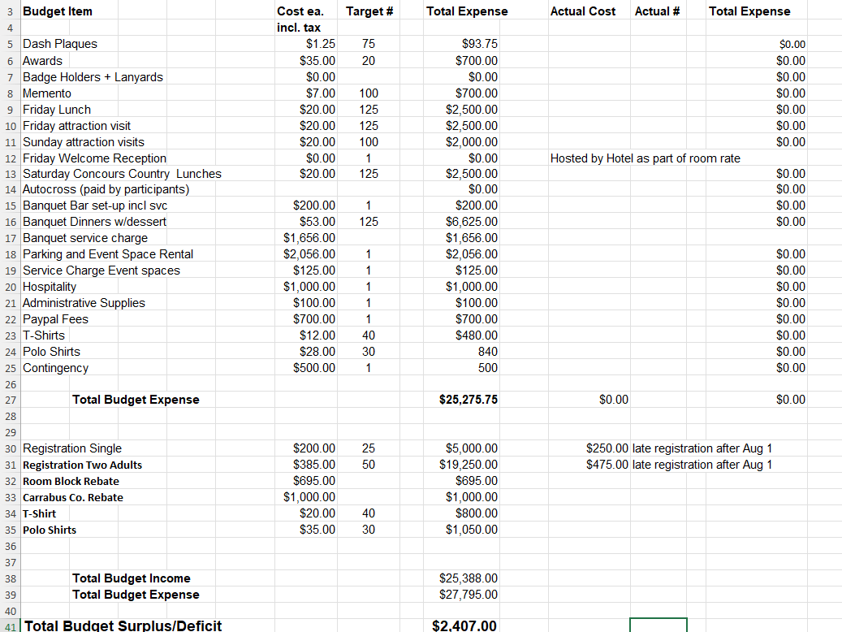

Slide 22
Donation to TEAE
Ron Estes, longtime member has stipulated in his will that his Sunbeam Tiger MkIA be donated to the club.
Car is a decent personalized driver with 289 swap, located in MD. Original engine accompanies car.
Ron has advised that disposition of car is totally at our discretion…including sale.
My initial research did not reveal any legalities which would prevent the club from accepting.
Since Ron is a member income realized is within 501 (c) 3 limits
Discussion: Hopefully, the actual donation will not happen for years but…
How do we title?
Where do we store/how do we maintain?
Disposition options?
Update on legal issues

Slide 23
SUNI VIII (2026) Update
Contacted by Claudia Trippel from CAT. Wanted to know if TEAE has interest in participating/organizing
Venue candidates focus on same general location as SUNI VII…slightly favors east coast
Springfield, MO
Joplin, MO
Financial risks and gains shared among participating clubs same as SUNI VII
Board Approved participation in principle pending final details
No significant progress. Still looking for host hotel. Most likely in Springfield, MO area.

Slide 24
New Business
Rootes Archive Donation
Last donation: $500 April 2023
United 40 donation: $575 Sep 2023
Does club want to make donation?
Discussion/Motion/Vote?
Lord Rootes Individual Awards
Award Recipients receive two badges engraved with year of award
Mounted on bumper bracket
Mounted on Engraved plaque
Failed to give out individual awards 2022 & 2023
Ron Stein and Bill Bullpit
Had to restock plaques
Switched to less expensive wood plaque with black marble finish
Engraving four badges, purchasing and engraving name plate and mounting on plaque cost $212

Slide 25
New Business
New Banners
Do we want to acquire?
Any other Paraphenalia?
Discussion/Motion/Vote
Action officer selection

Slide 26
Wrap Up
Any other items to Discuss?
Motion to Adjourn

Slide 27
Backup Slides

Slide 28
5 Year Summary
CY | 2018 | 2019 | 2020 | 2021 | 2022
Starting Balance | 22281 | 20403 | 17660 | 17988 | 19068
Ending Balance | 2040 | 17660 | 17988 | 19068 | 23061
Membership | 17090 | 15831 | 16158 | 15930 | 16398
Newsletter | 20447 | 20062 | 15708 | 16679 | 16298
 | -3357 | -4231 | 450 | -749 | 100
SUNI | 0 | 0 | 0 | 0 | 3699
United | 3057 | 7524 | 3096 | 0 | 4355
RAC Donations | 502 | 500 | 1200 | 0 | 0
$s Verified – Clerical Error
Thanks for letting me be Treasurer for 5 years,
We welcome: Steve Murphy

Slide 29
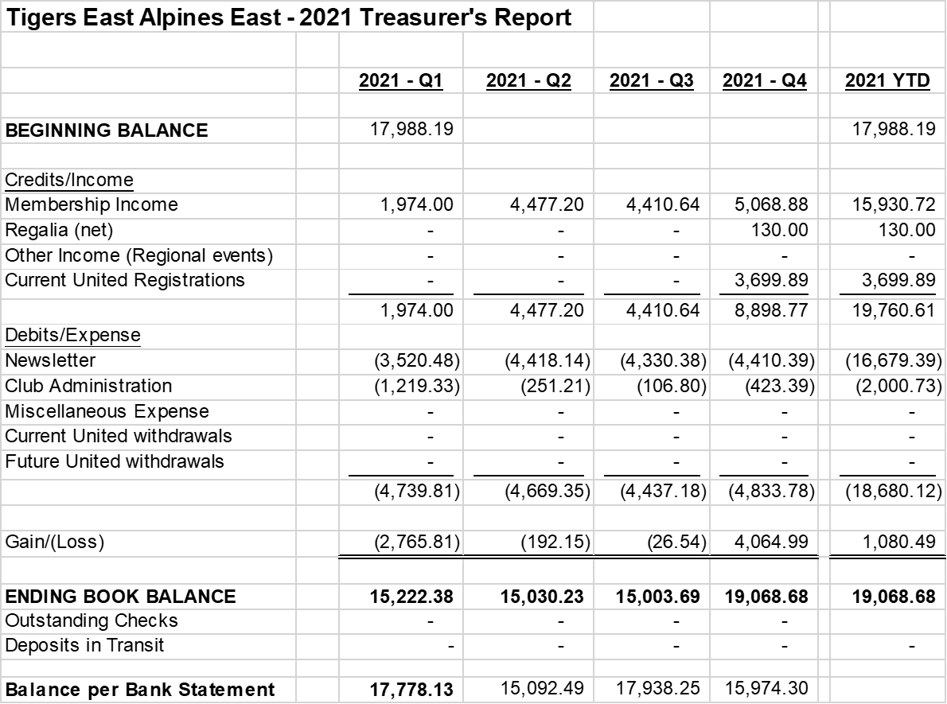
2021 Balance Sheet

Slide 30
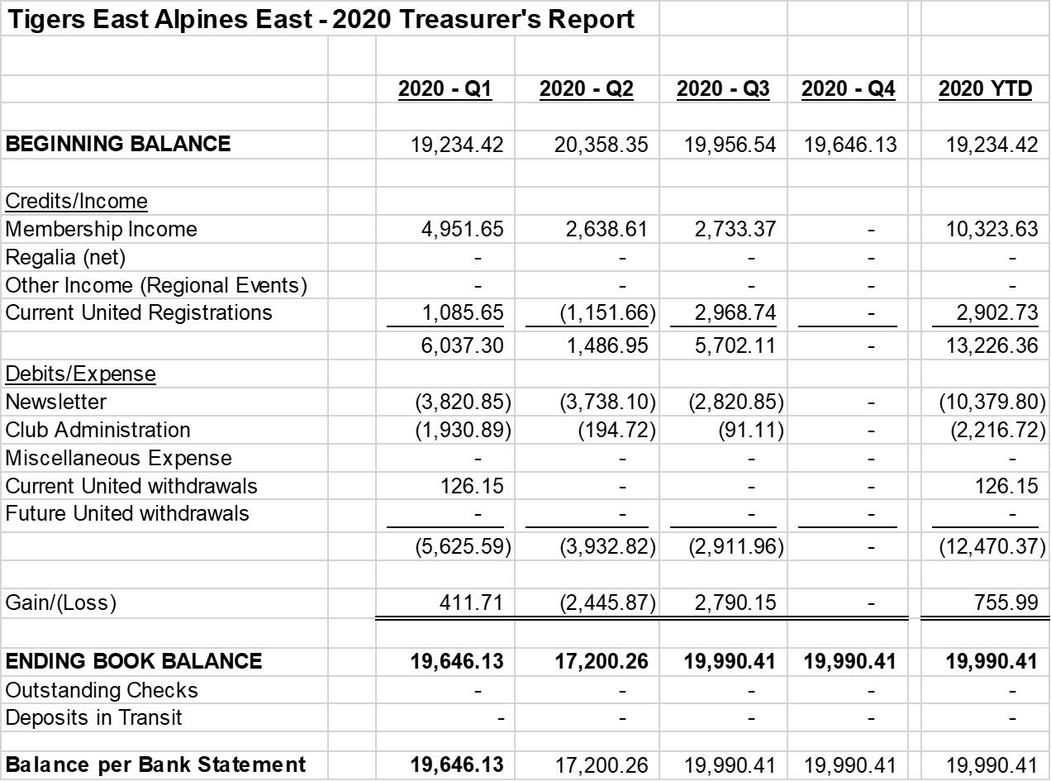
2020 Balance Sheet

Slide 31
2019 Balance Sheet

